Slide 1
GWP Reproduction & Genetics
Protocol for the collection of eggs and evaluation of quality using a 96-well microtiter (mct or ELISA) plate
Objectives:
To estimate the egg production parameters of broodstock, using a method that can be implemented for a large number of batches, and which allows evaluation of larval survival to yolk sack absorption,
Use a common method for all experiments with the same species, and if possible with all species.

Slide 2
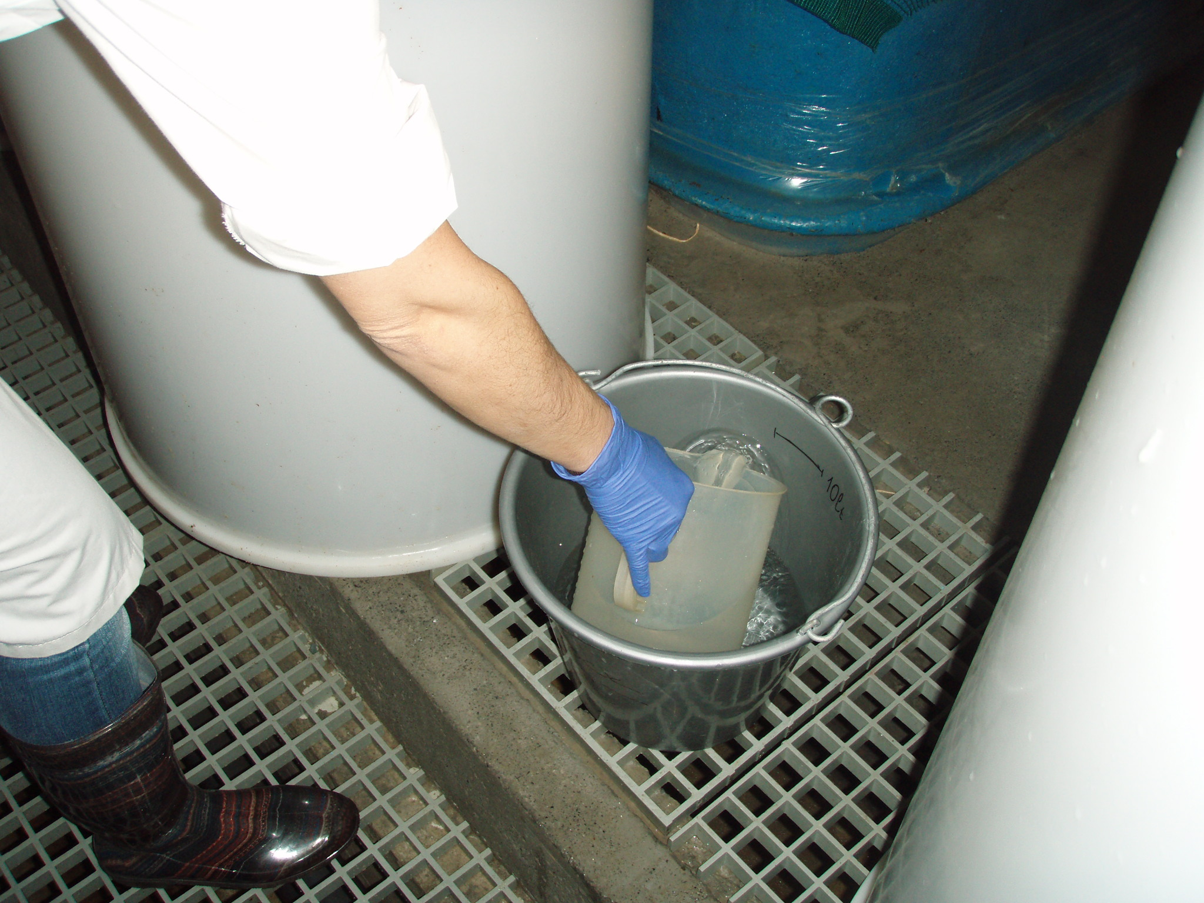
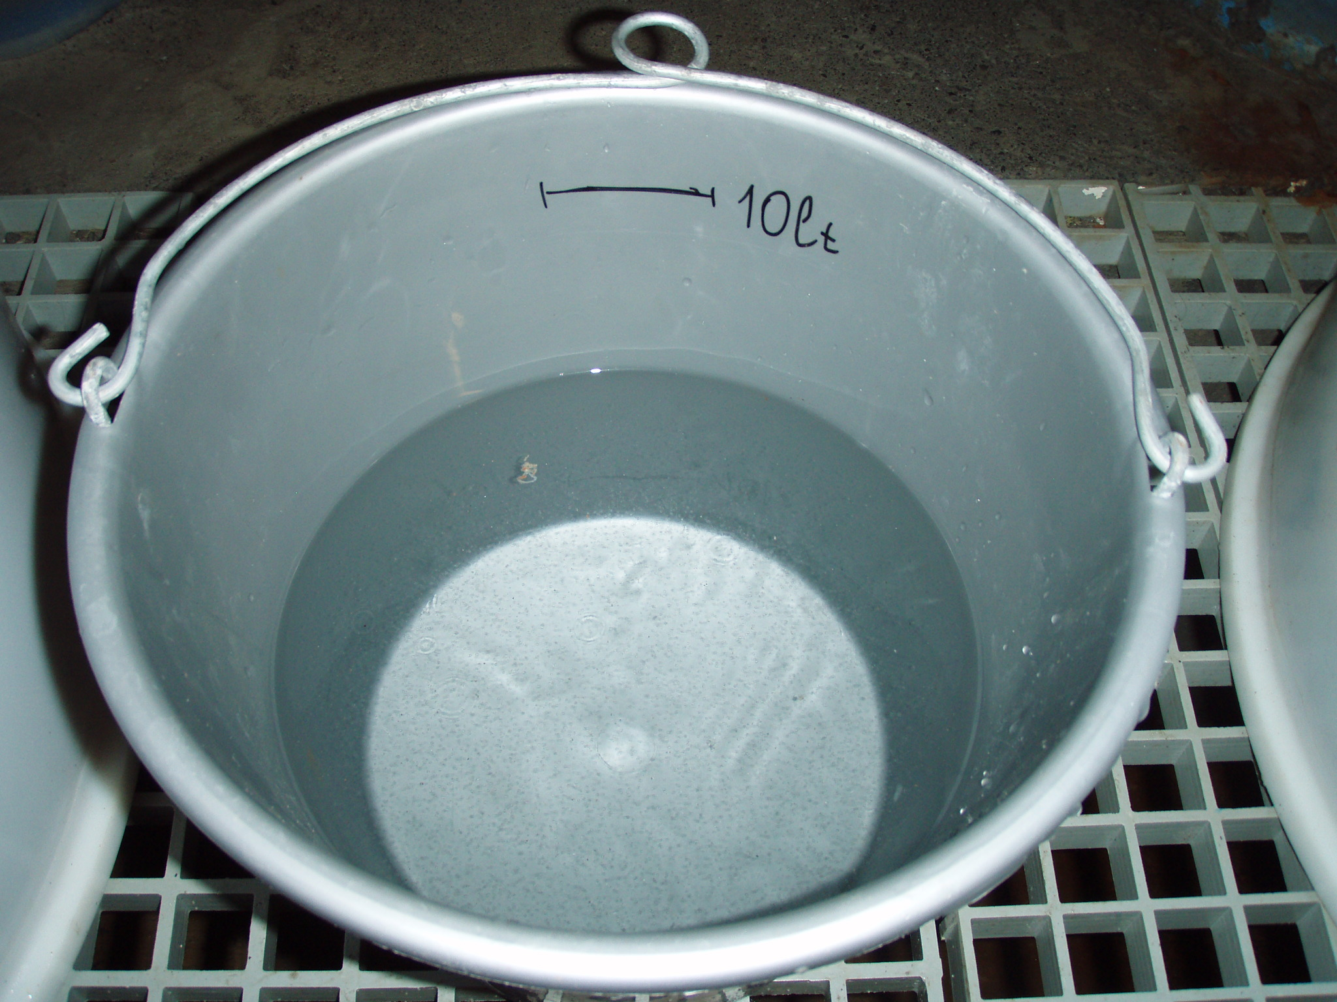
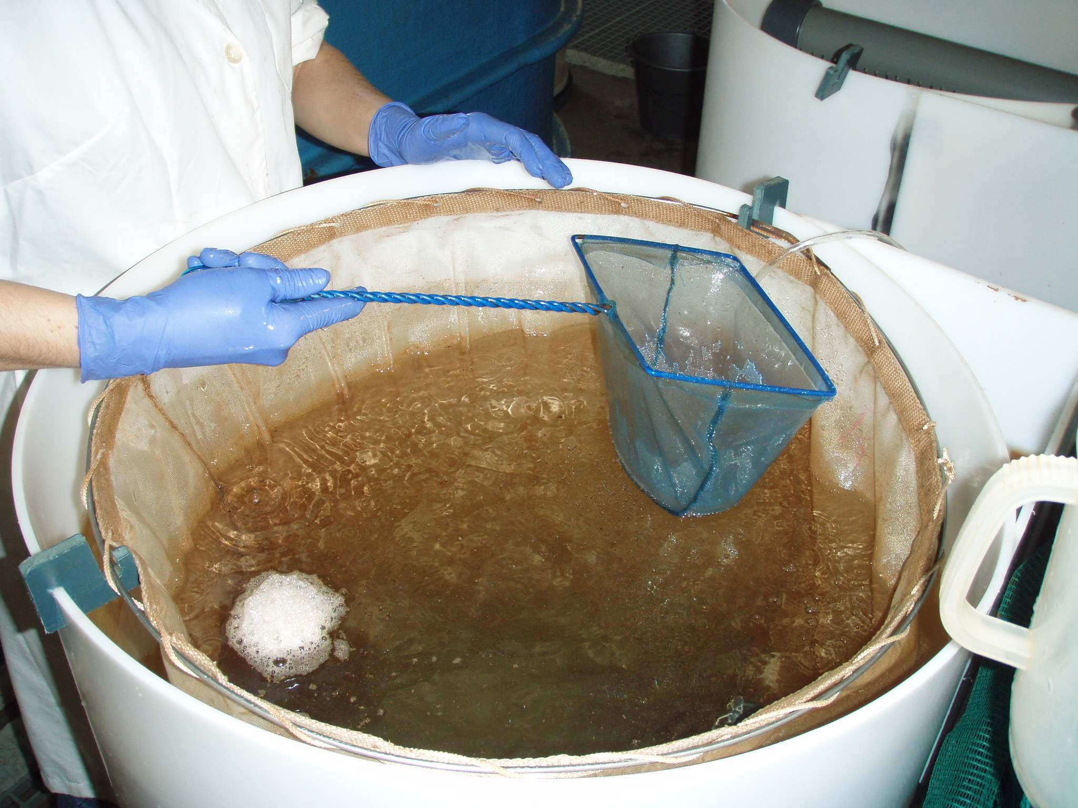
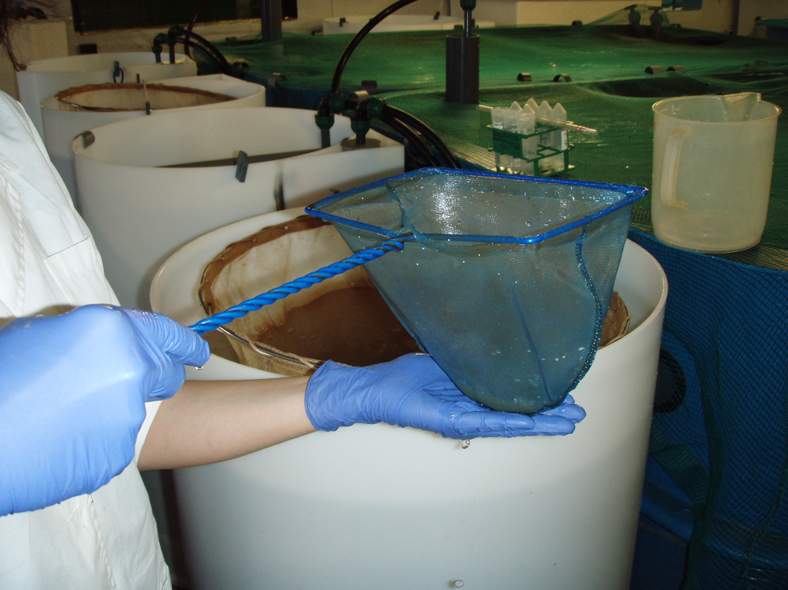
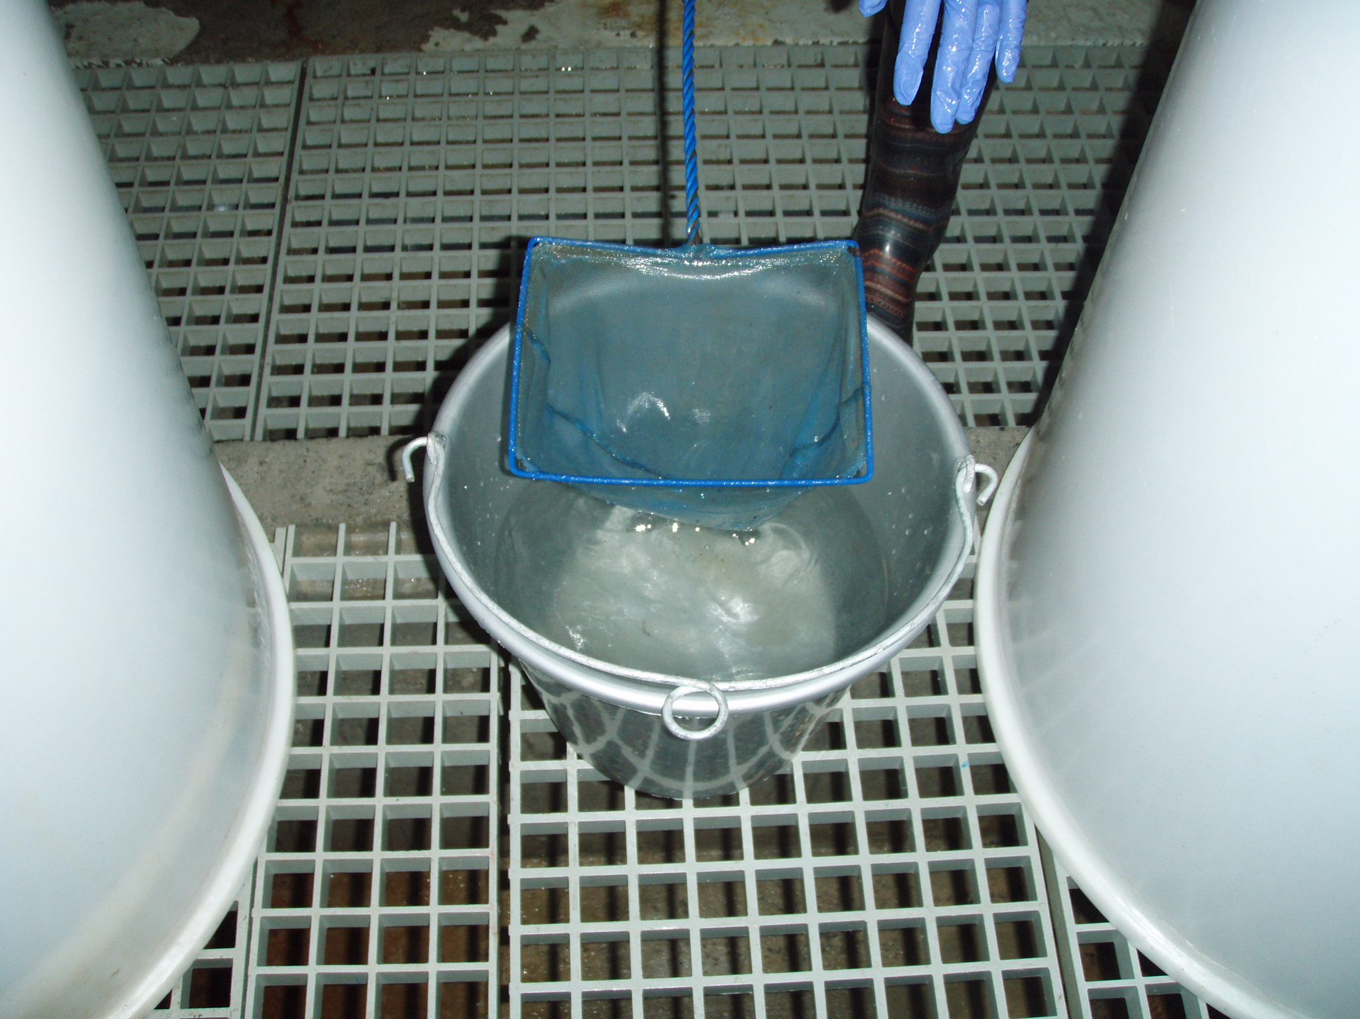
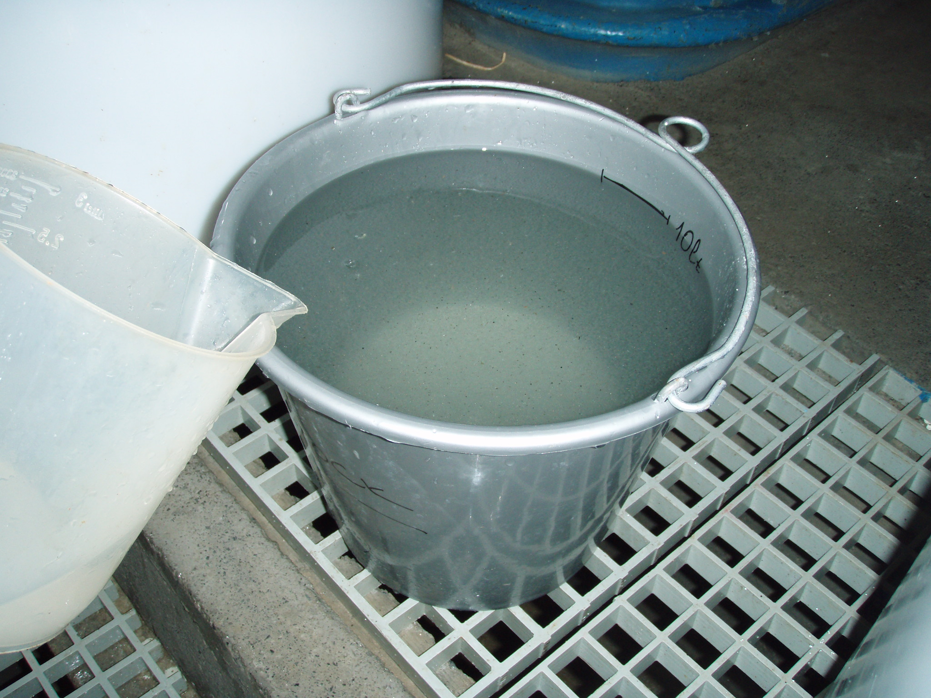
Egg collection from spawning tanks (Step 1):
Collect all eggs from the overflow egg collector in a 10-l bucket (make a horizontal mark on the bucket at the 10-l mark).
First put 5 l of water from the egg collector in the bucket.
Then using a plankton dipnet, collect the eggs from the egg collector, strain them gently to remove excess water and add in the bucket.
Repeat until all (almost all!) eggs have been collected. Top up the bucket to the 10-l mark.

Slide 3
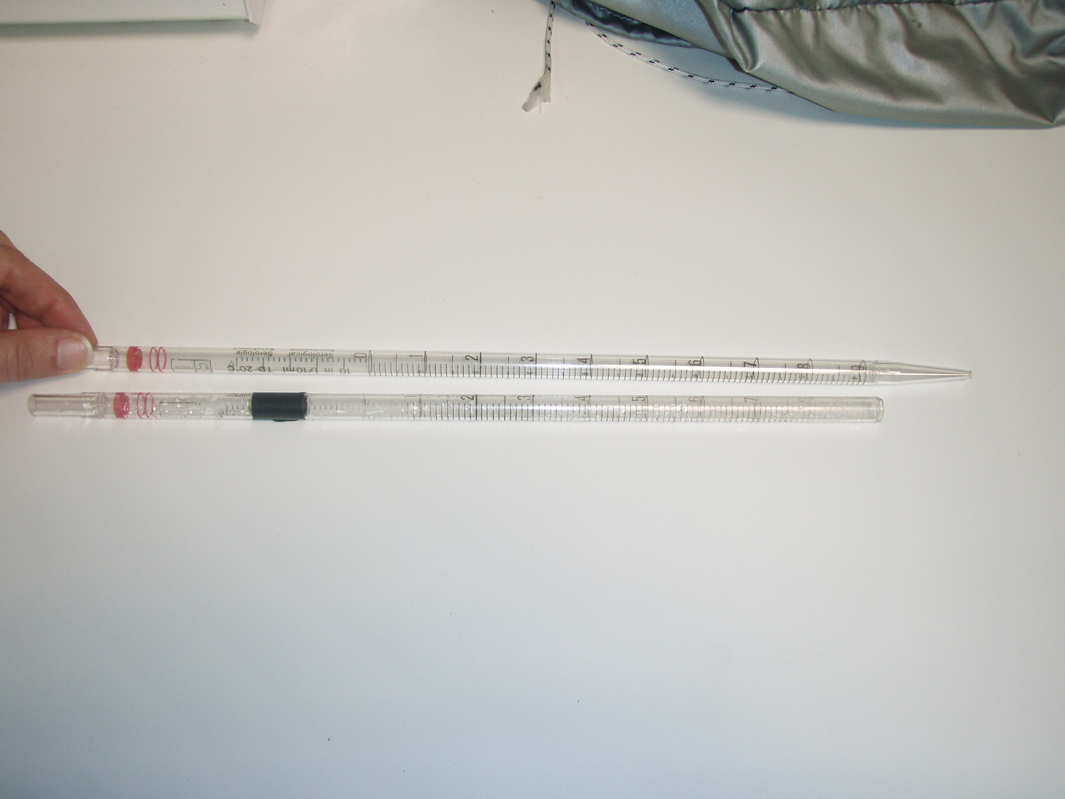
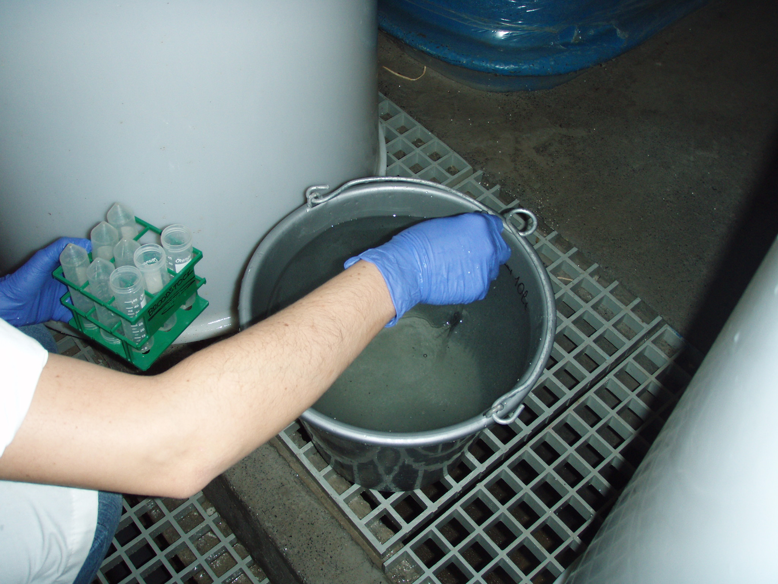
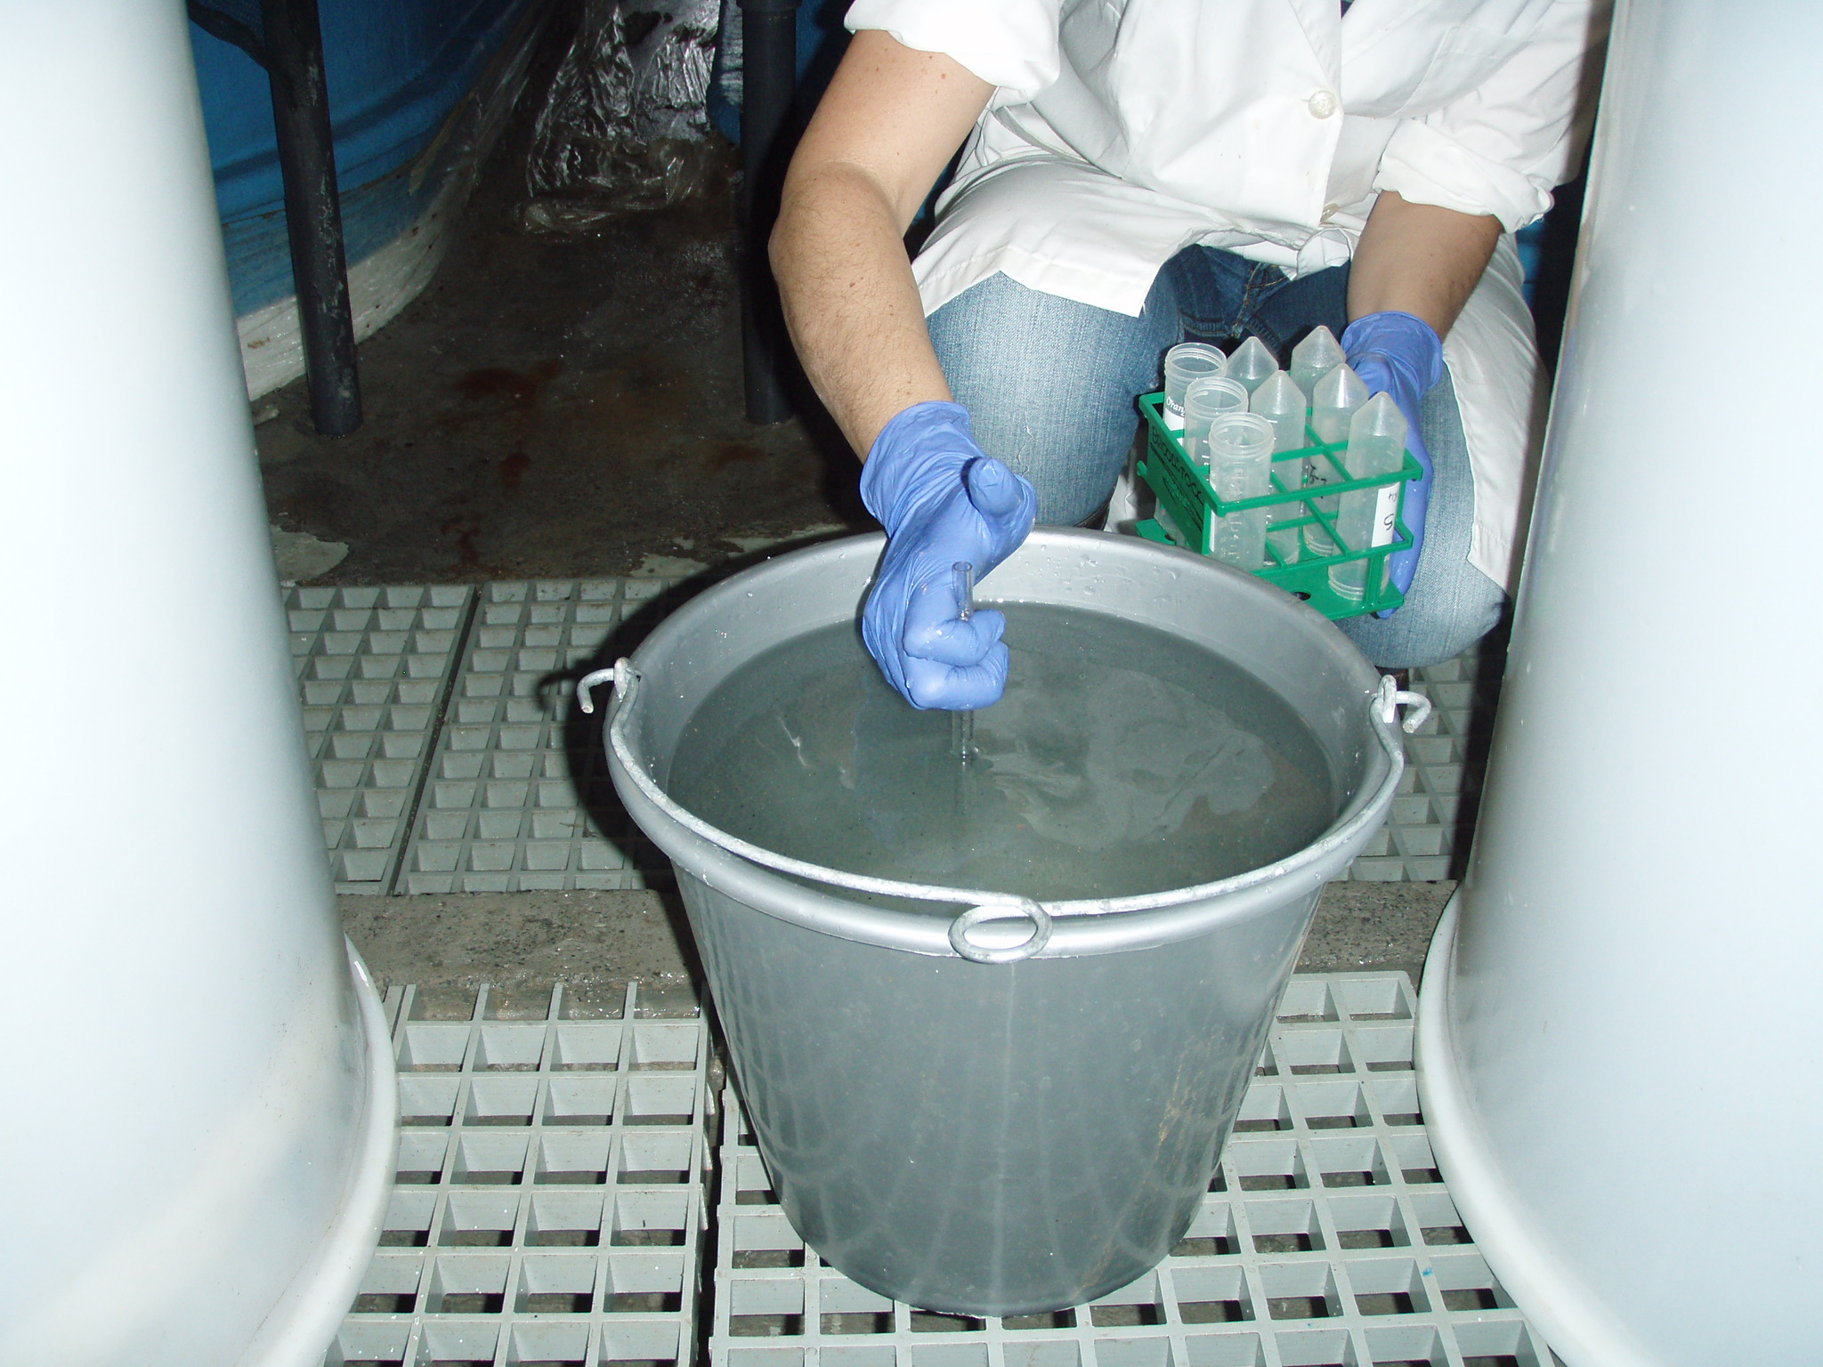
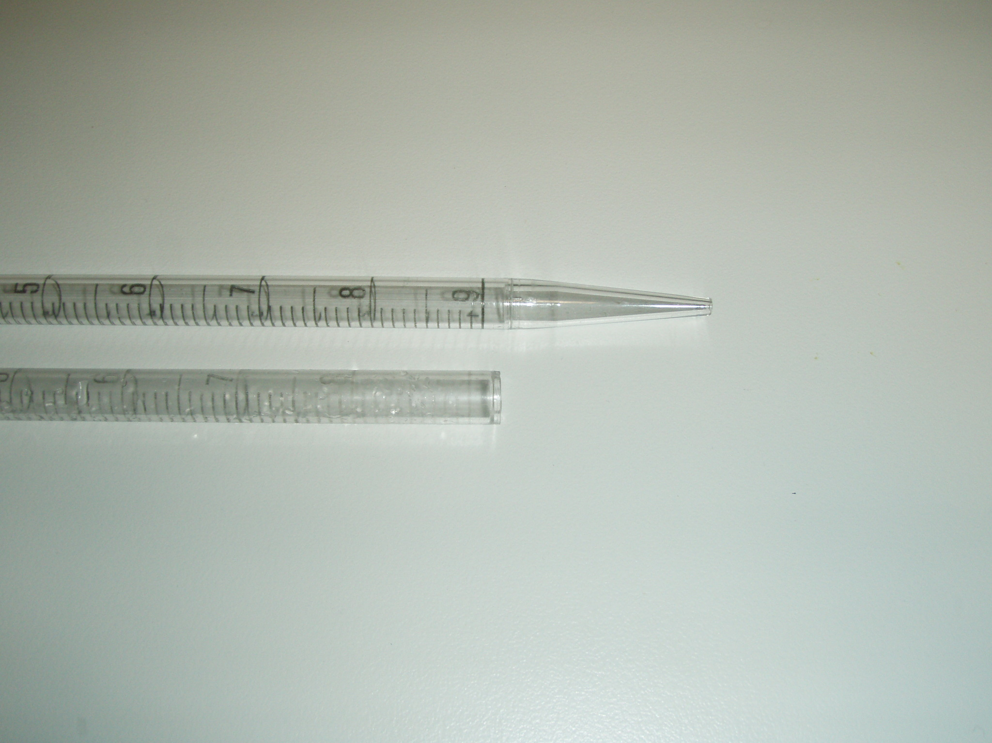
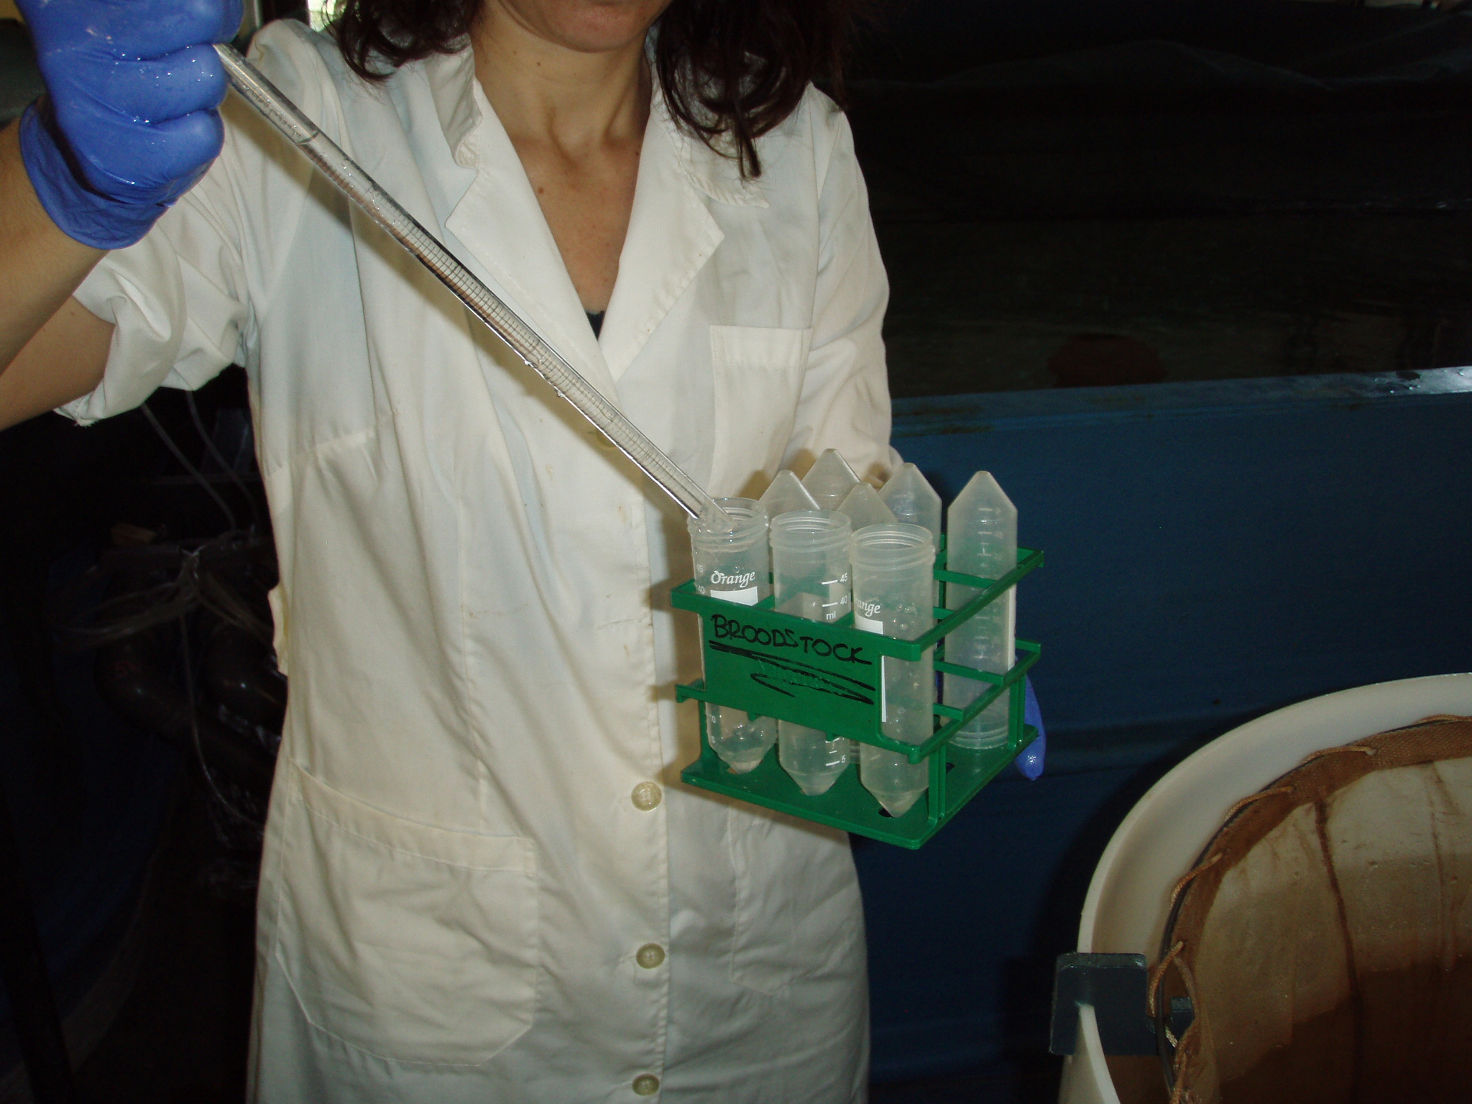
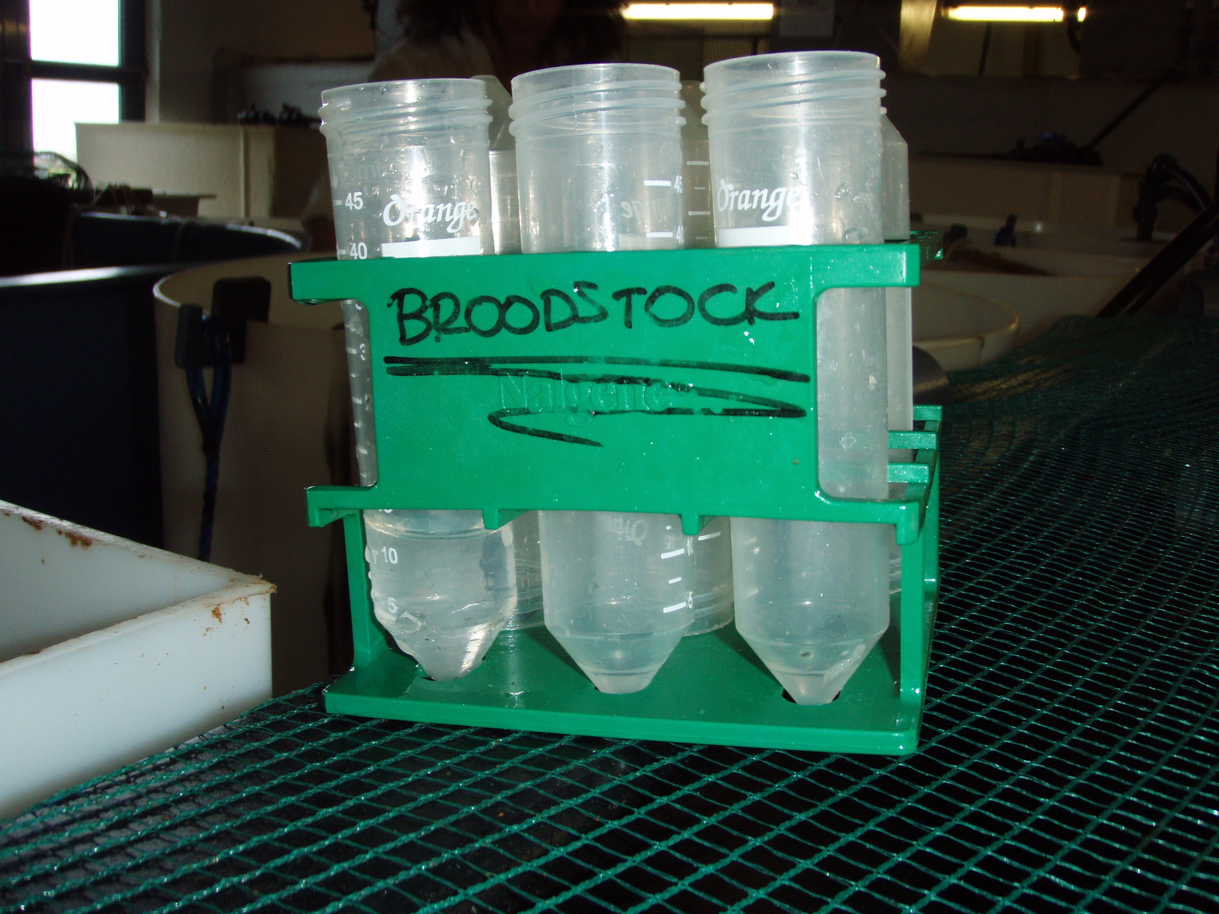
Egg sampling for fecundity and fertilization % (Step 2):
Take a 10-ml plastic pipet and cut off the conical tip to allow water to enter faster. These pipetes are usually graduated to the 12 ml mark and the conical tip starts at the 9 ml mark. So if the conical tip is cut off, aspirating to the 11 ml mark will contain 10 ml.
Using the pipette, mix the water with the eggs in the 10-l bucket thoroughly to dispers uniformly the eggs.
Then in a swift motion, sink the cut-off 10-ml pipette into the bucket until the pipette fills up to the 11 ml mark (for our buckets-pipettes, almost to the bottom of the bucket). Use your thumb to tap (clog) the top of the pipette, so that you will avoid overfilling or spilling the collected egg-water sample.
Place the sample into a 17 or 50 ml Falcon tube. The eggs contained in this sample should be 1/1000nd of the number of eggs spawned (contained in the 10-l bucket). If the amount of eggs in the egg collector is >500,000, then you must sample only 5 ml with the same procedure, to avoid having to look and count too many eggs. If it is >1 million, then you will need to do a sub-sample before counting.
Continue to the next egg collector and then when you are finished, you can take these 10-ml samples to the lab for counting and evaluation of fertilization percentage (Step 4).

Slide 4
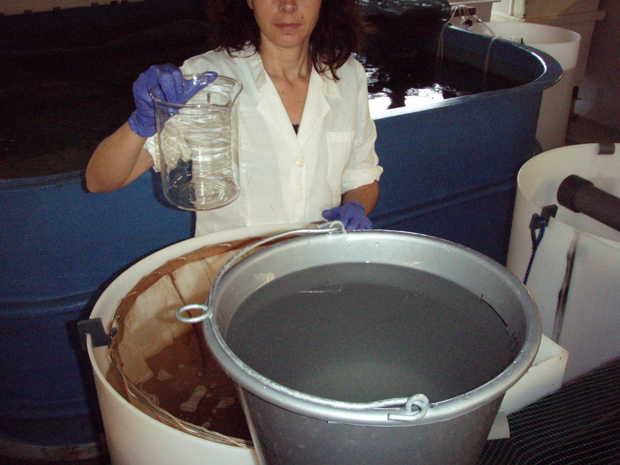
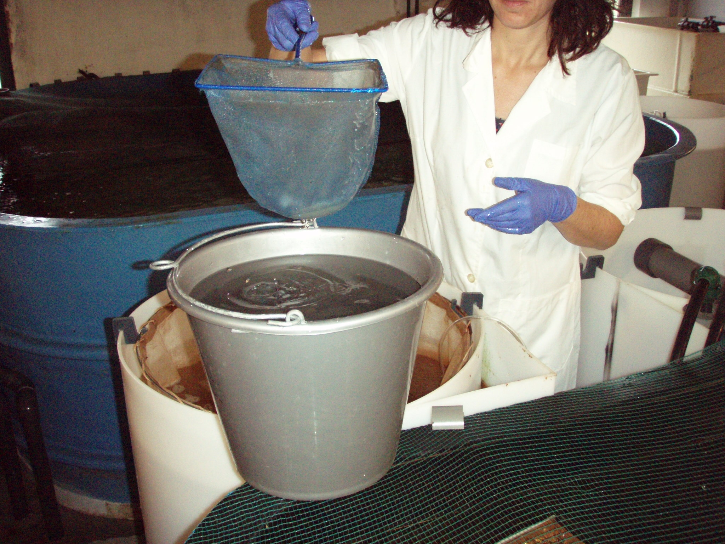
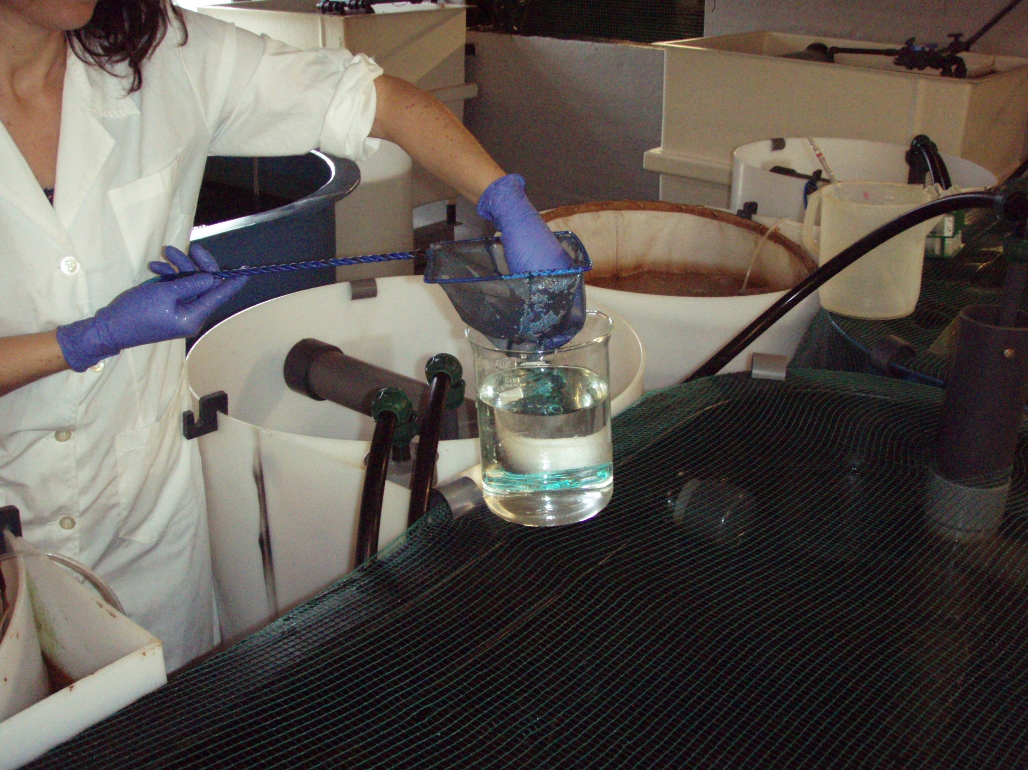
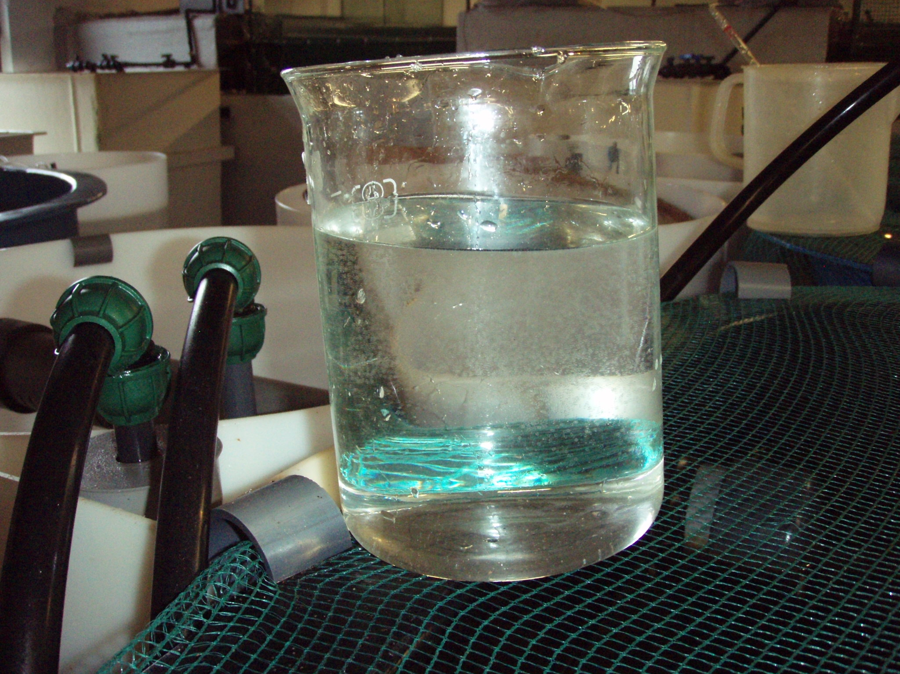
Egg sampling for microtiter plate loading (Step 3):
To get a sample for loading the microtiter (mct) plates, let the water and eggs in the 10-l bucket to calm down (5 min) and float to the surface (viable eggs float, and these are the only ones you need from now on) and separate from the mostly dead eggs (sunk to the bottom).
Take a 2-l beaker and fill to the 1.5-l mark with clean seawater from the broodstock tank.
With the plankton dip net take a small quantity of floating eggs from the bucket (equal to ~ 2 soup spoonfulls) and put them in the beaker. Swirl gently.
Take this sample to the lab and put in the controlled-temperature incubator until you are ready to clean the eggs with sterilized-autoclaved water (Step 5) and load the mct plates (Step 6).

Slide 5
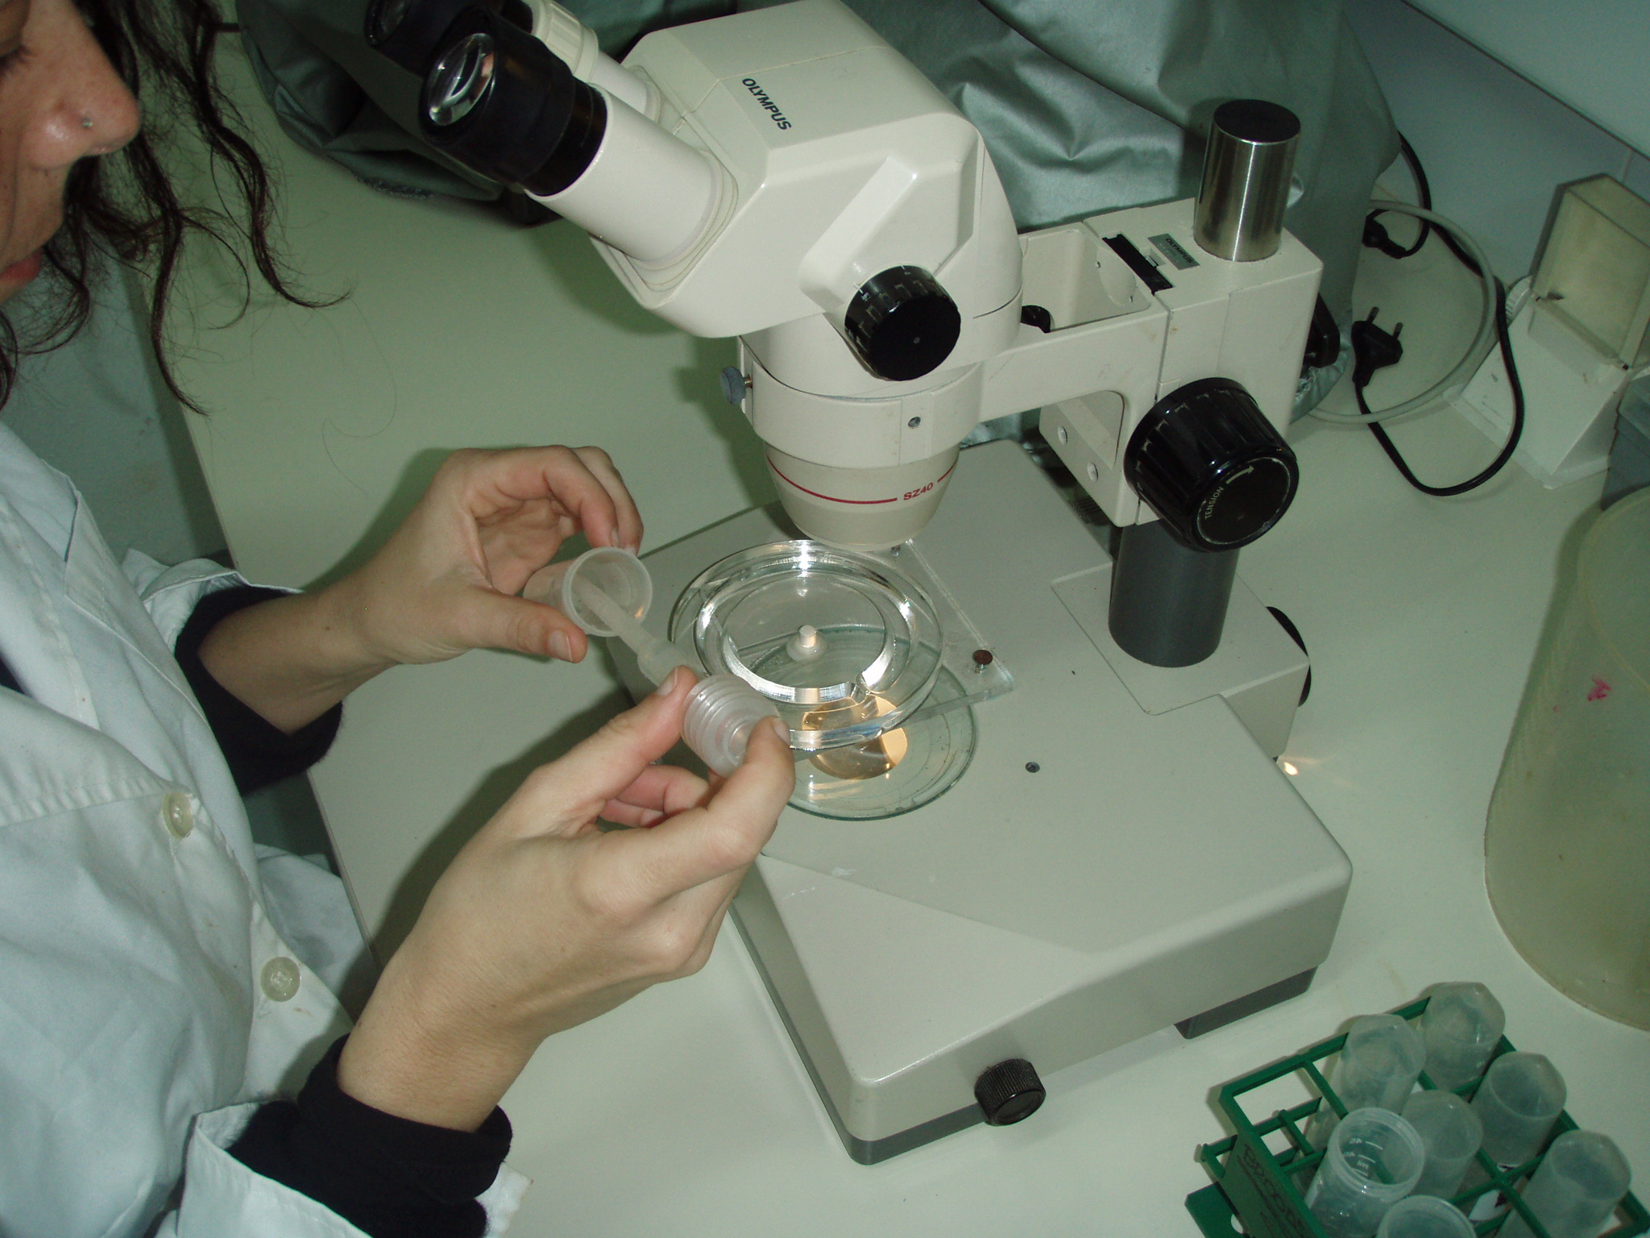
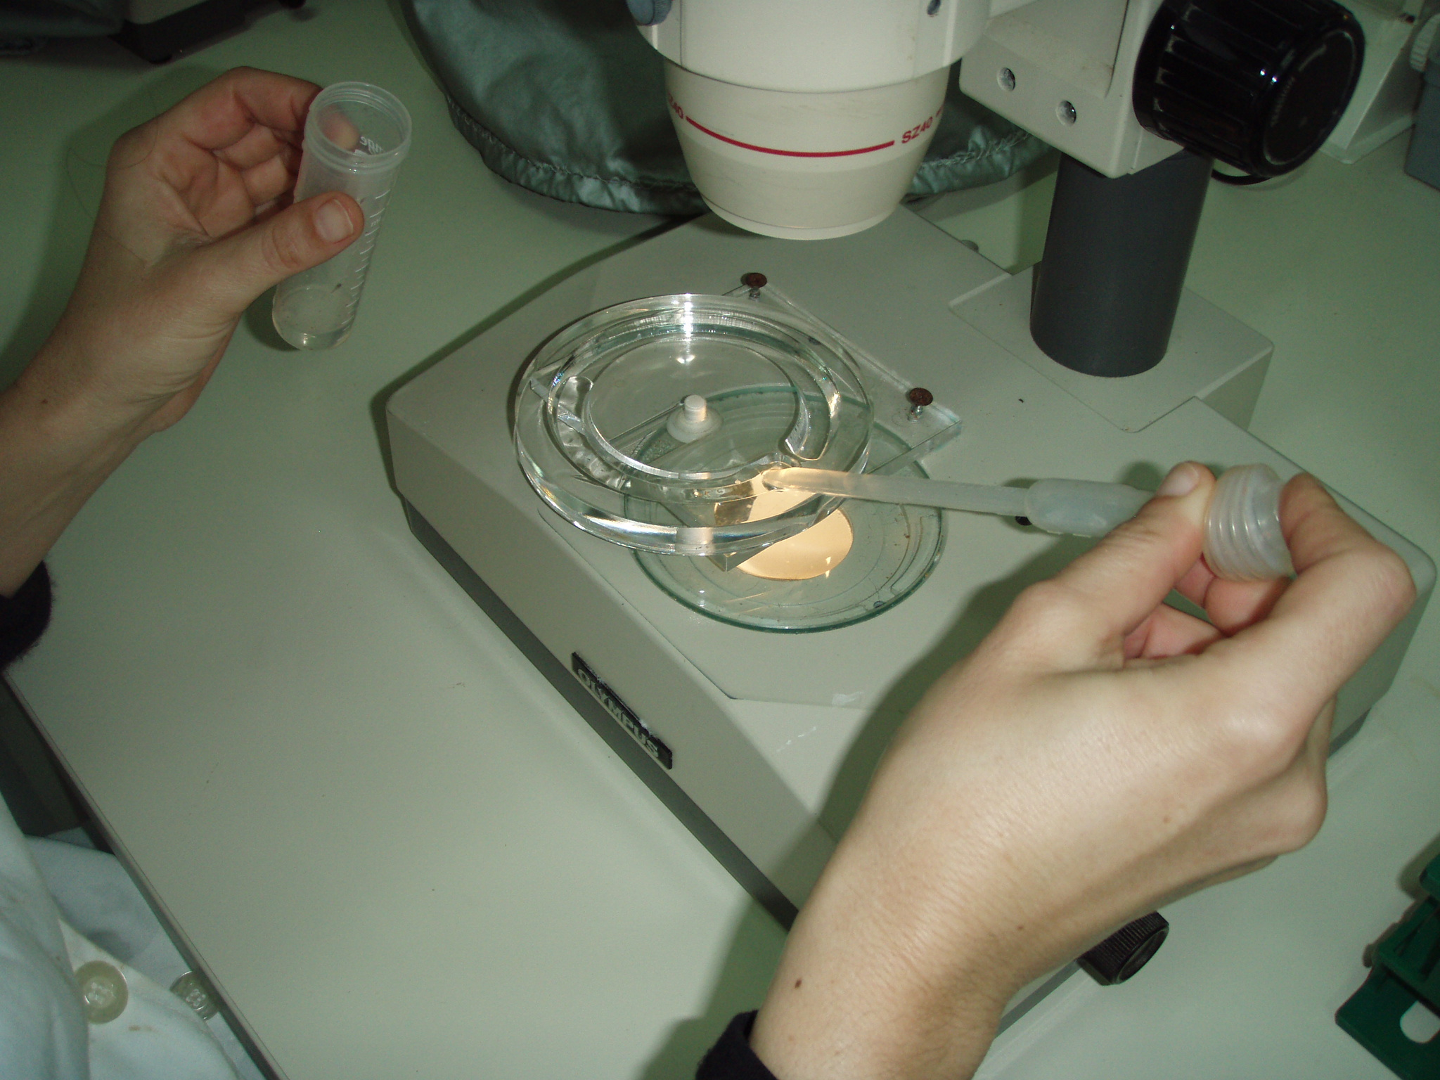
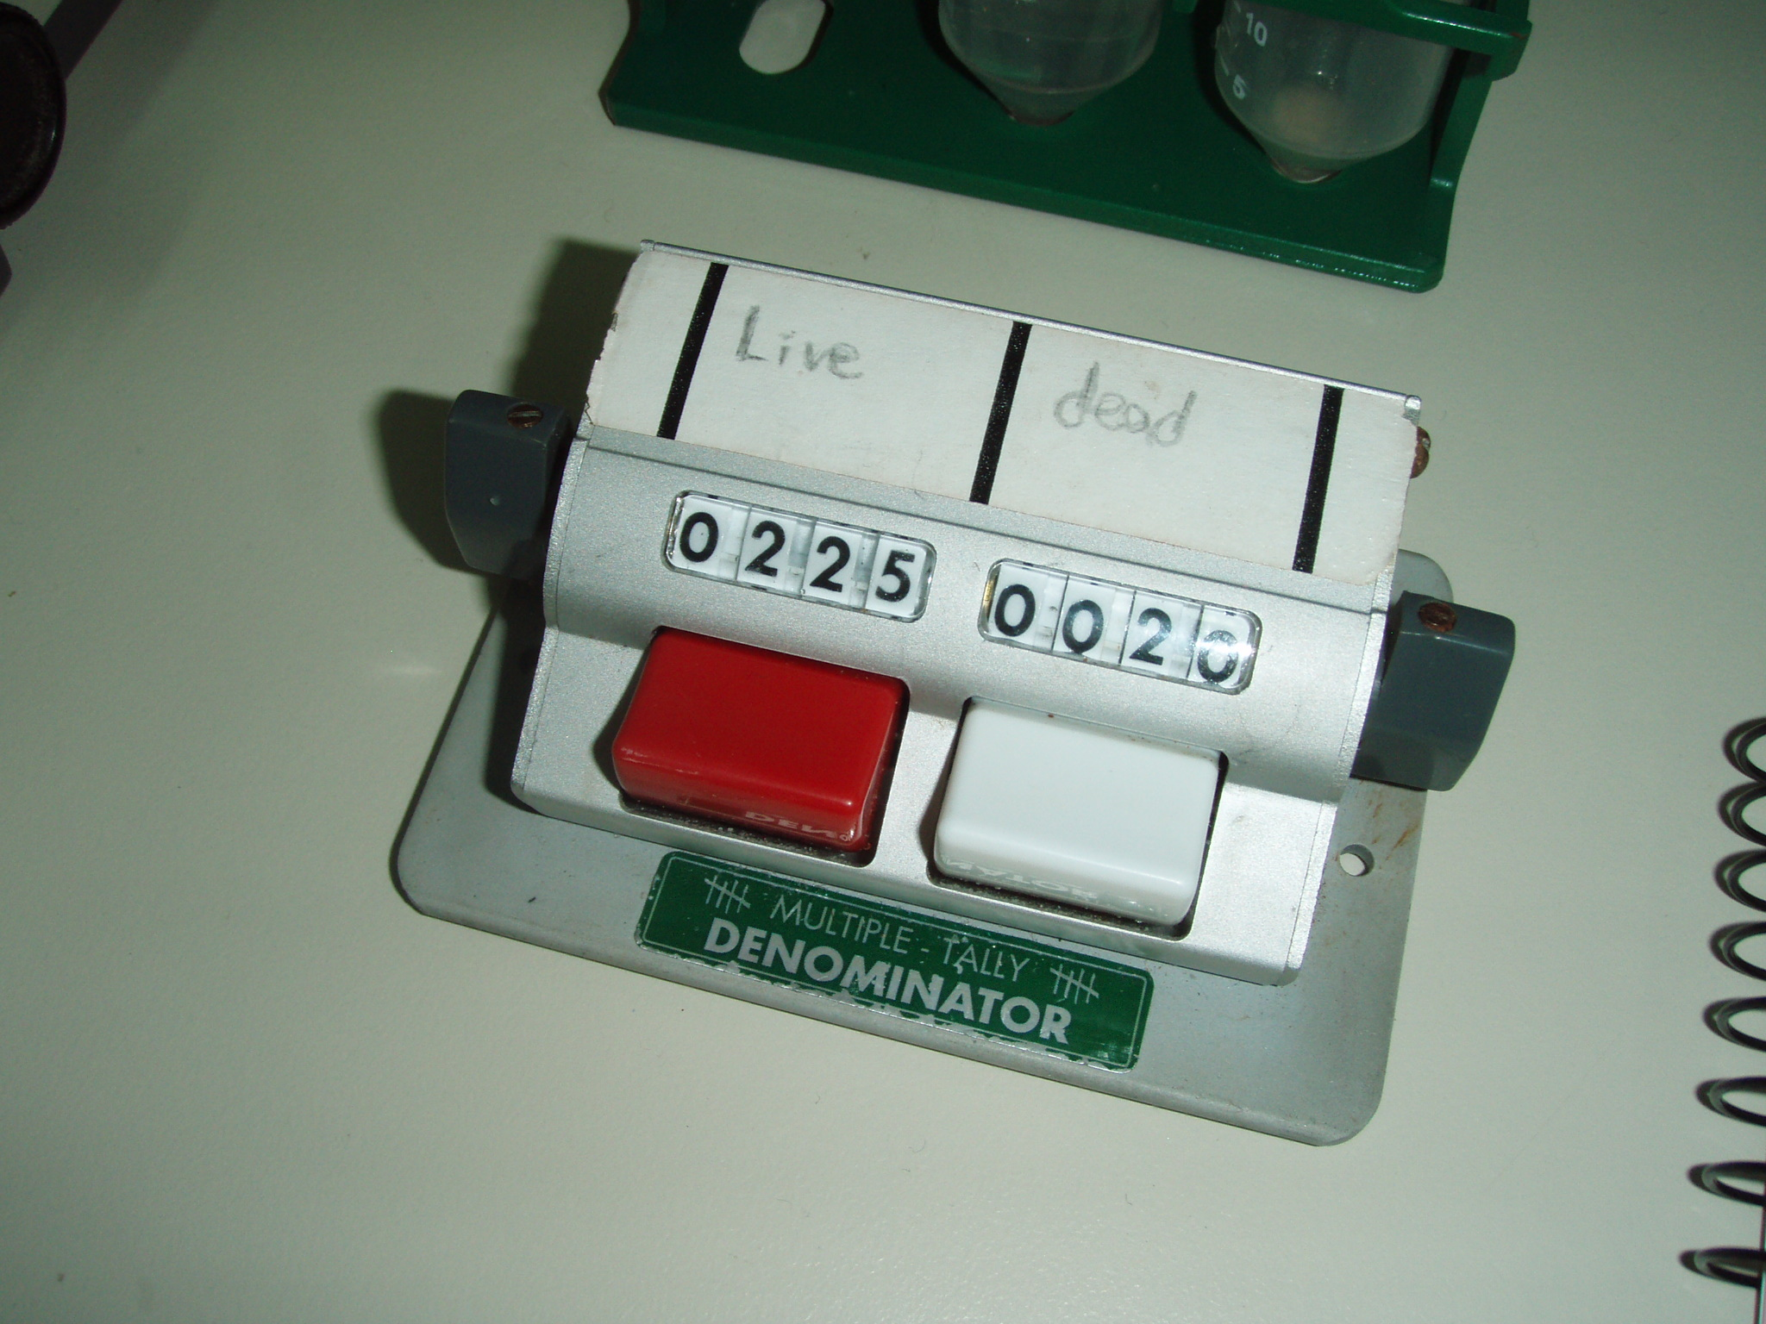
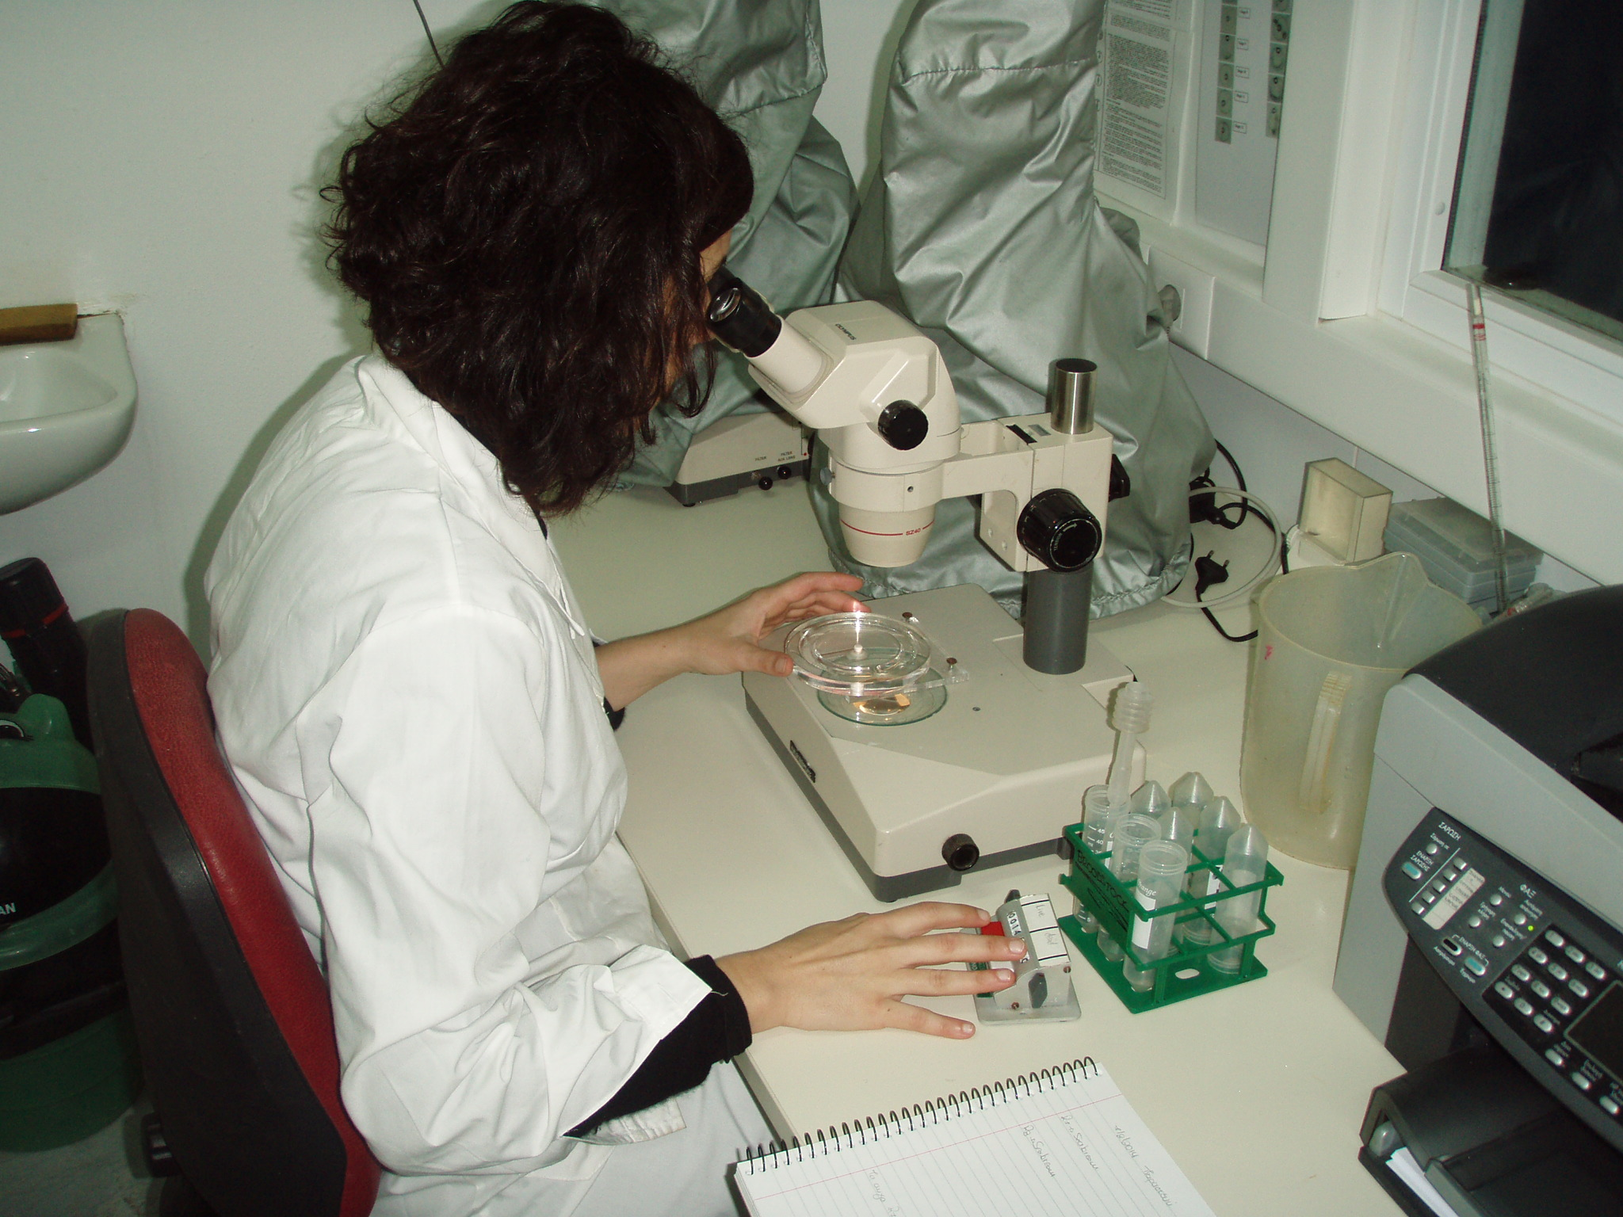
Evaluation of egg fecundity and fertilization success (Step 4):
Pour the 10-ml egg-water sample in a counting chamber (we use a circular one with a canal that has a dead end, so a start and an end to avoid counting the same eggs.
Using a cell counter, count the live (fertilized, L) and dead (D) eggs under the stereoscope.
The sum of (L + D) x 1000 is the fecundity of the spawn from where the sample was obtained.
The value of L/(L + D) is the fertilization percentage.

Slide 6
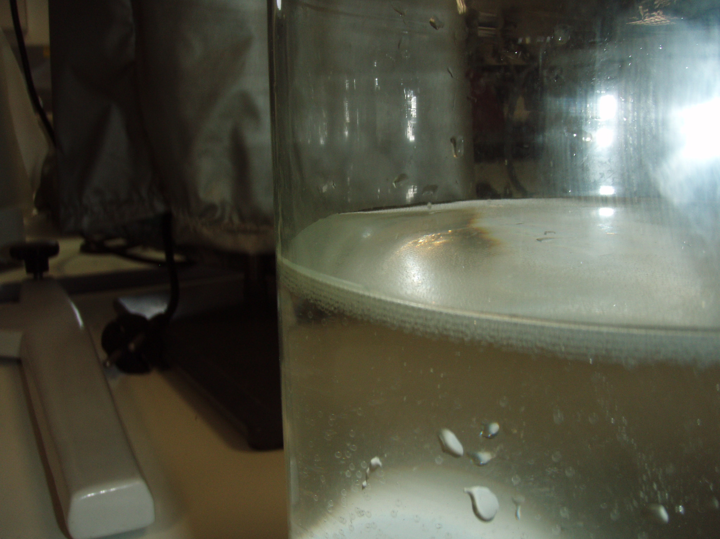
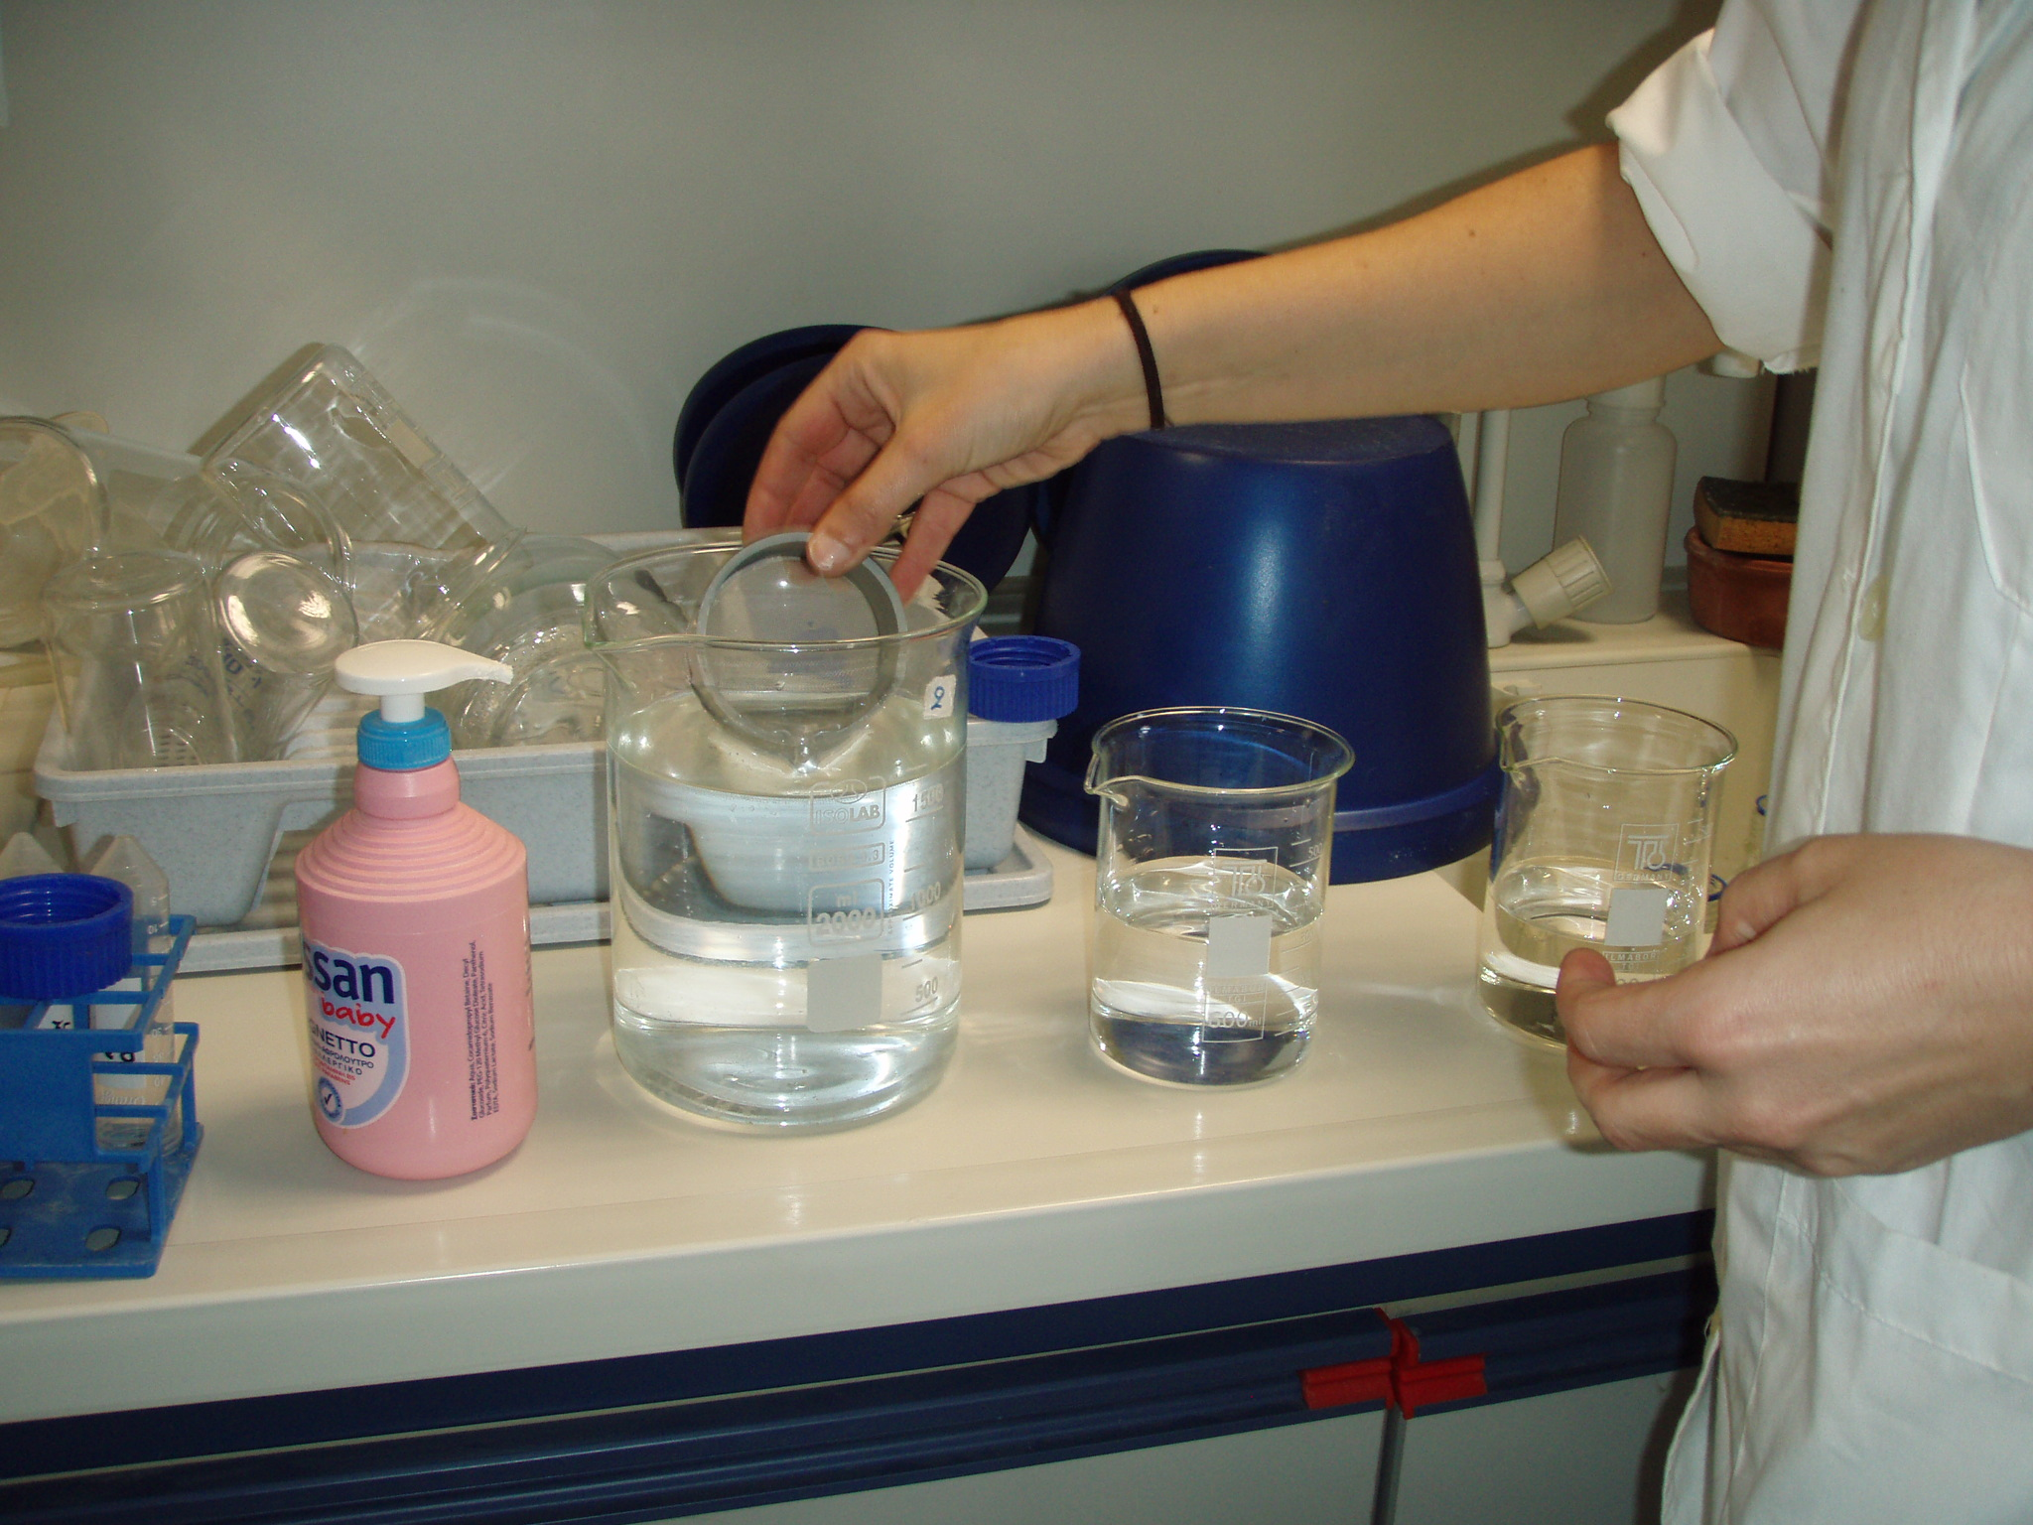
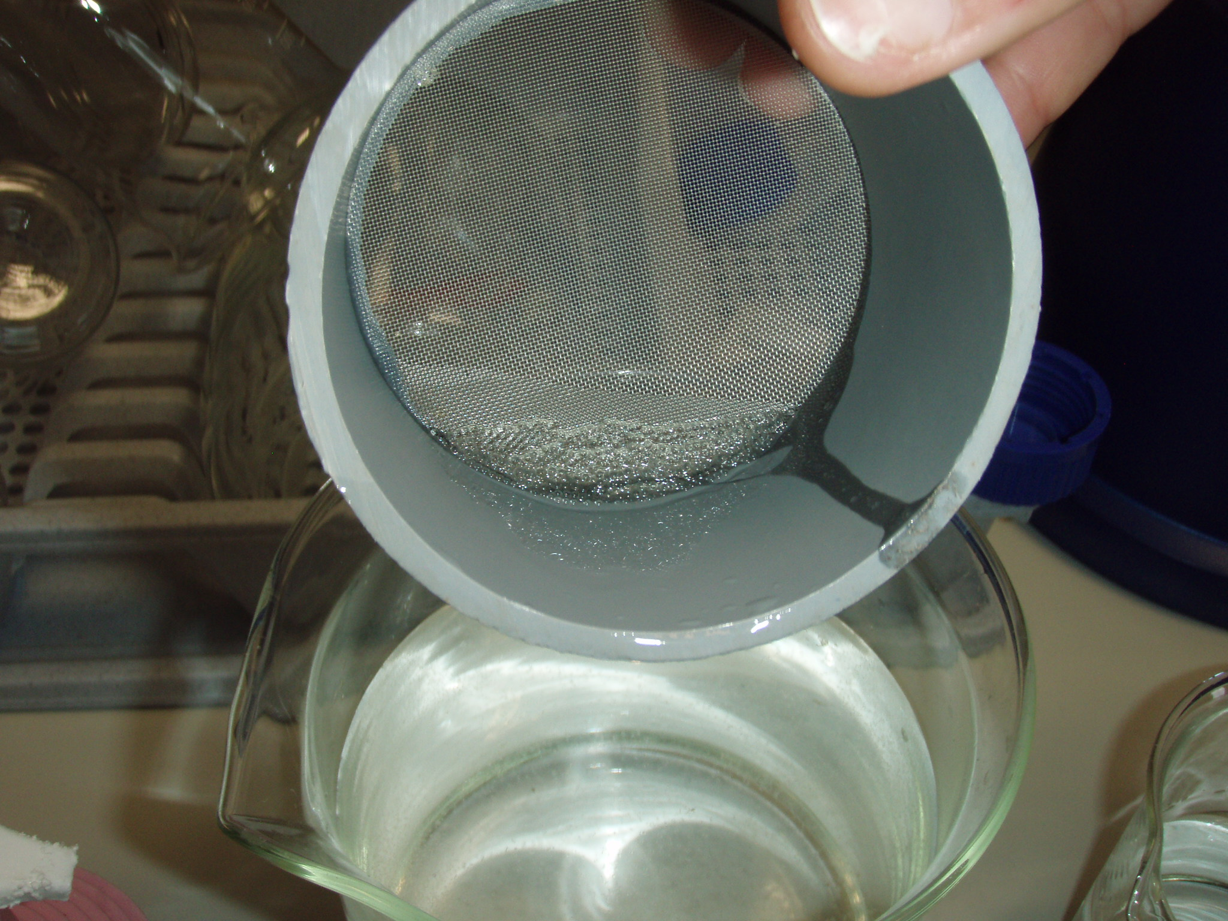
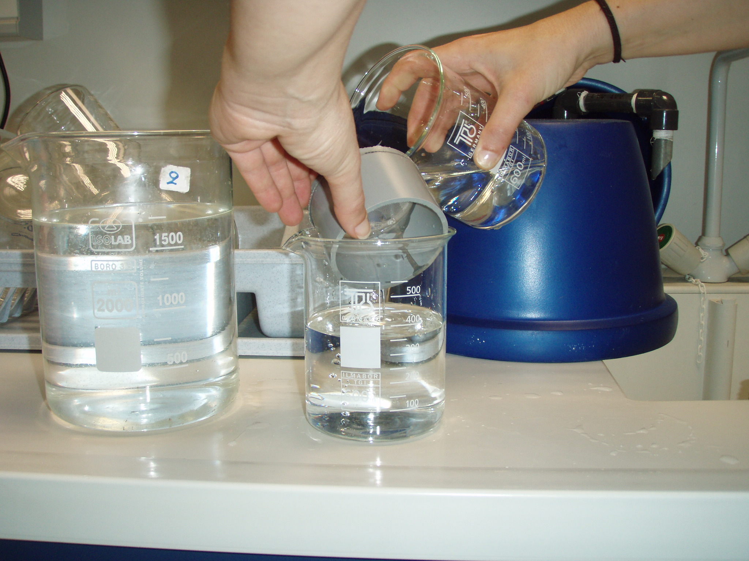
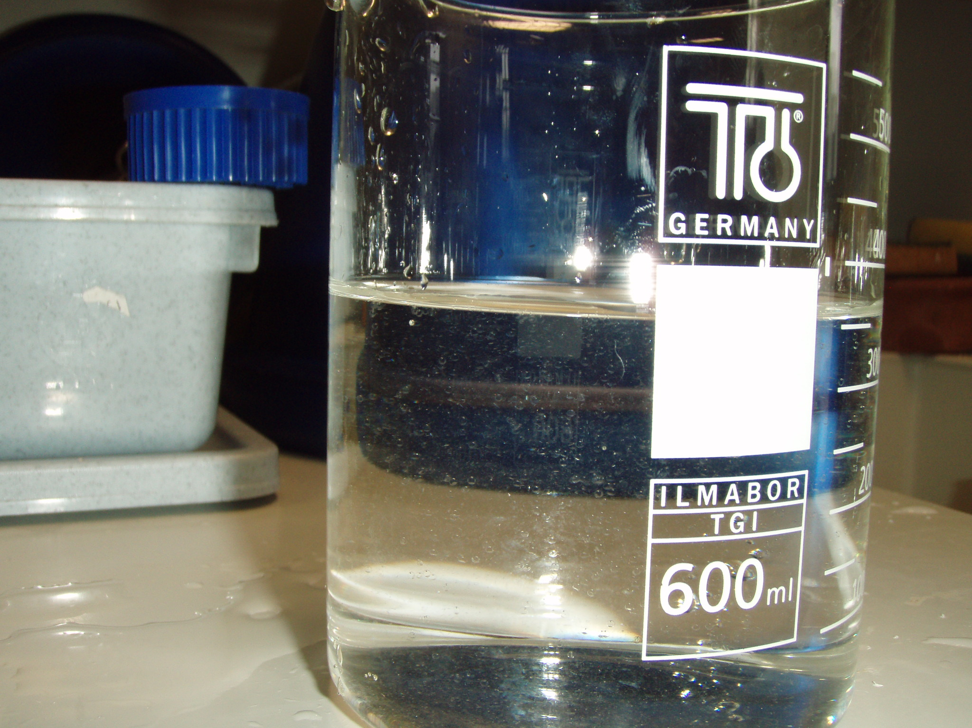
Cleaning the eggs for loading the microtiter plates (Step 5):
Fill two 500-ml beakers with sterilized seawater, maintained in the controlled temperature incubator at the spawning water temperature from where the eggs were collected.
With asmall sieve (custom made with 500-µm mesh) take some eggs from the 2-l beaker where the eggs were placed from the egg incubator (Step 3), left in the controlled temperature incubator (the eggs should be on the surface by now).
Wash them thoroughly with sterilized seawater from one of the 500-ml beakers.
Poor them into the other 500-ml beaker and swirl gently.
Allow them to come to the surface (5 min).

Slide 7
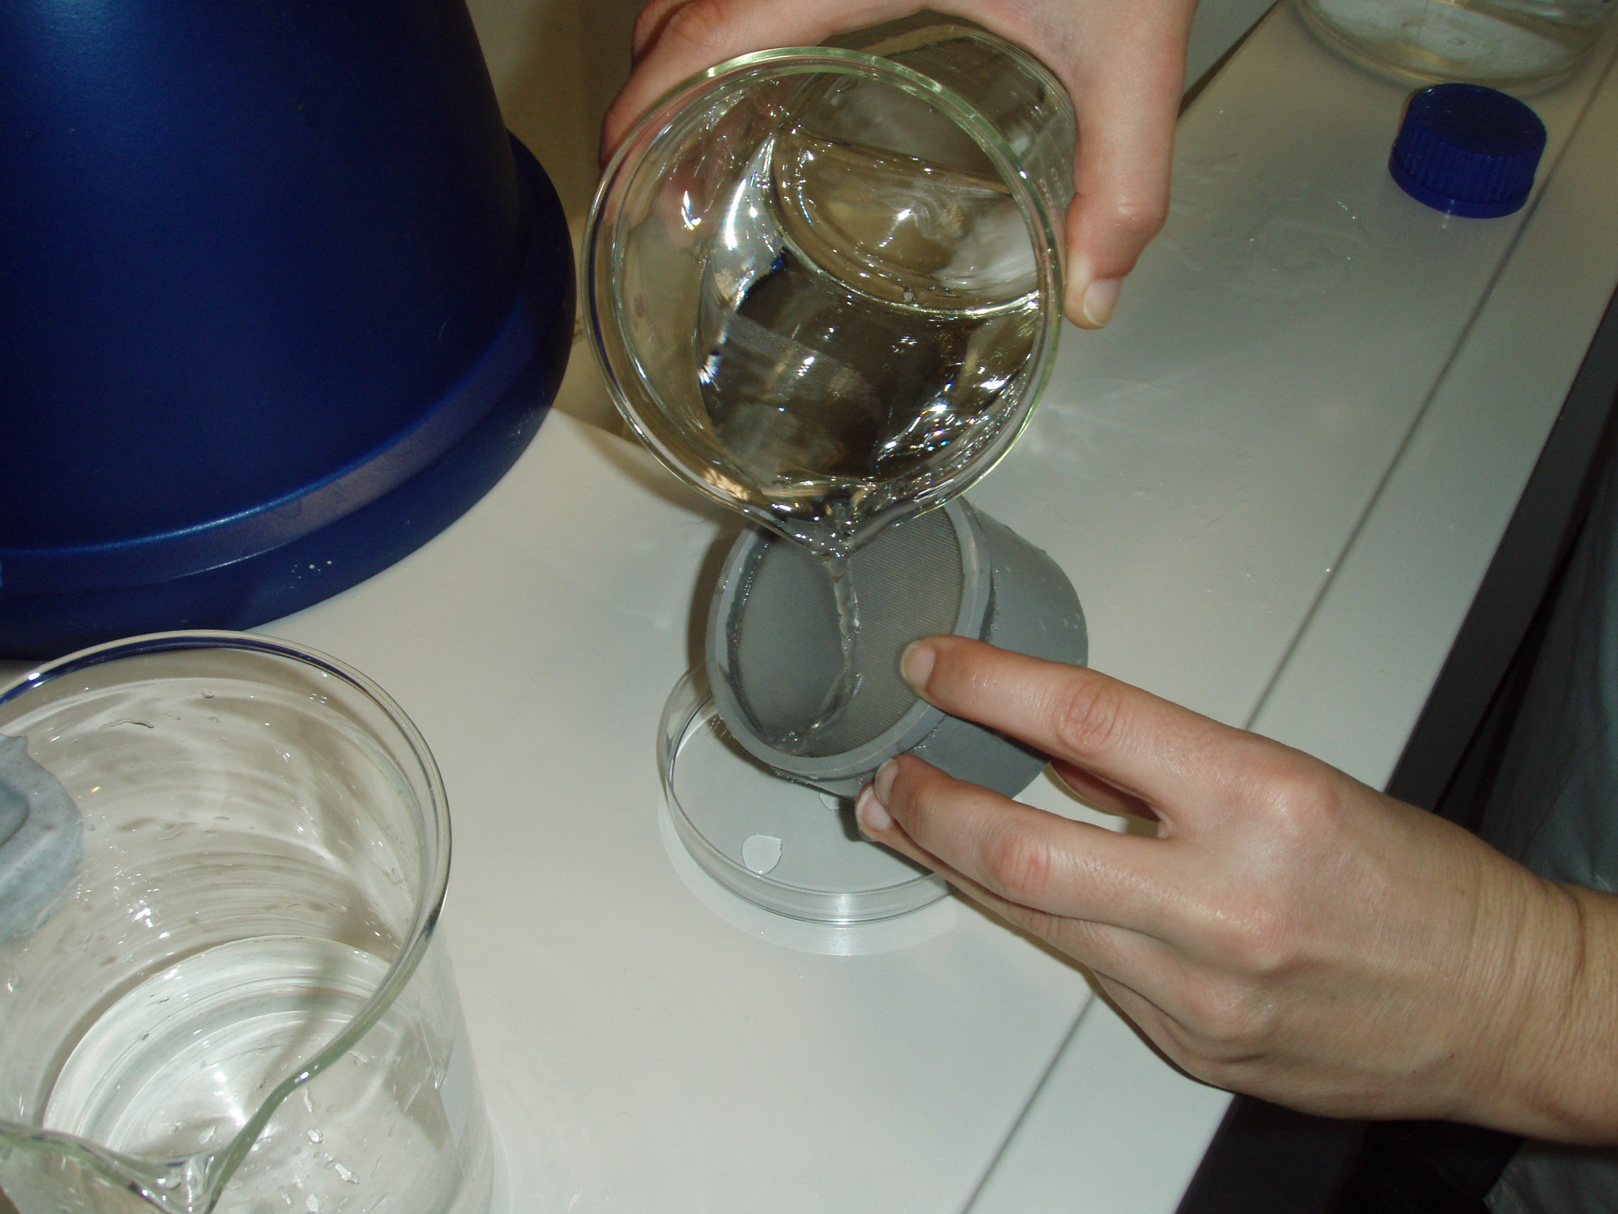
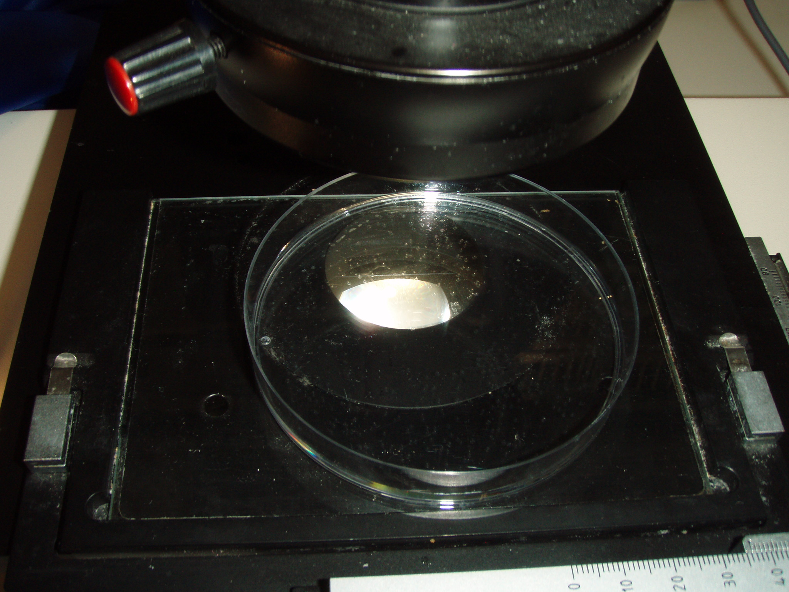
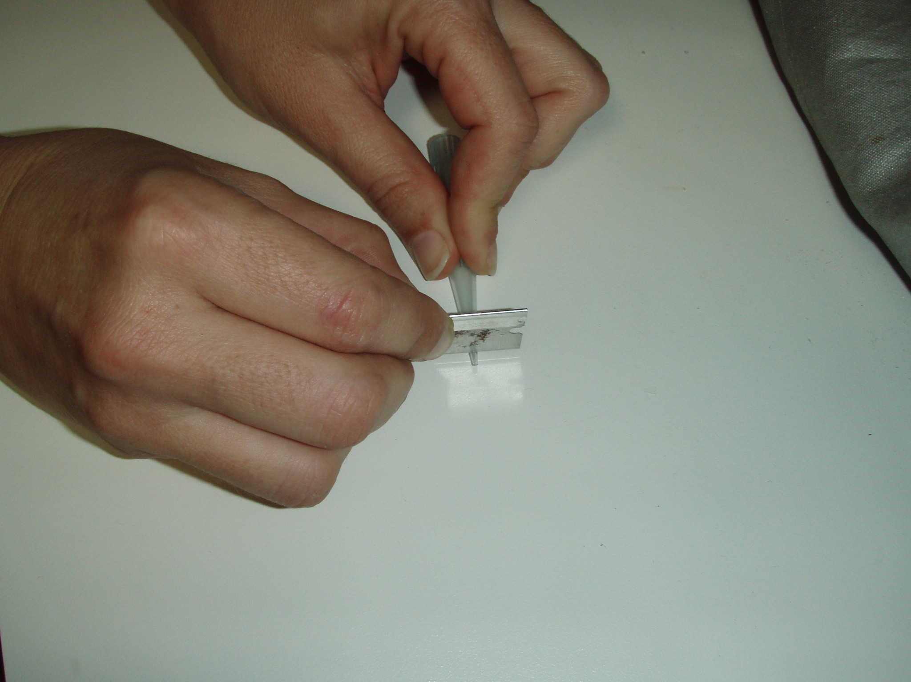
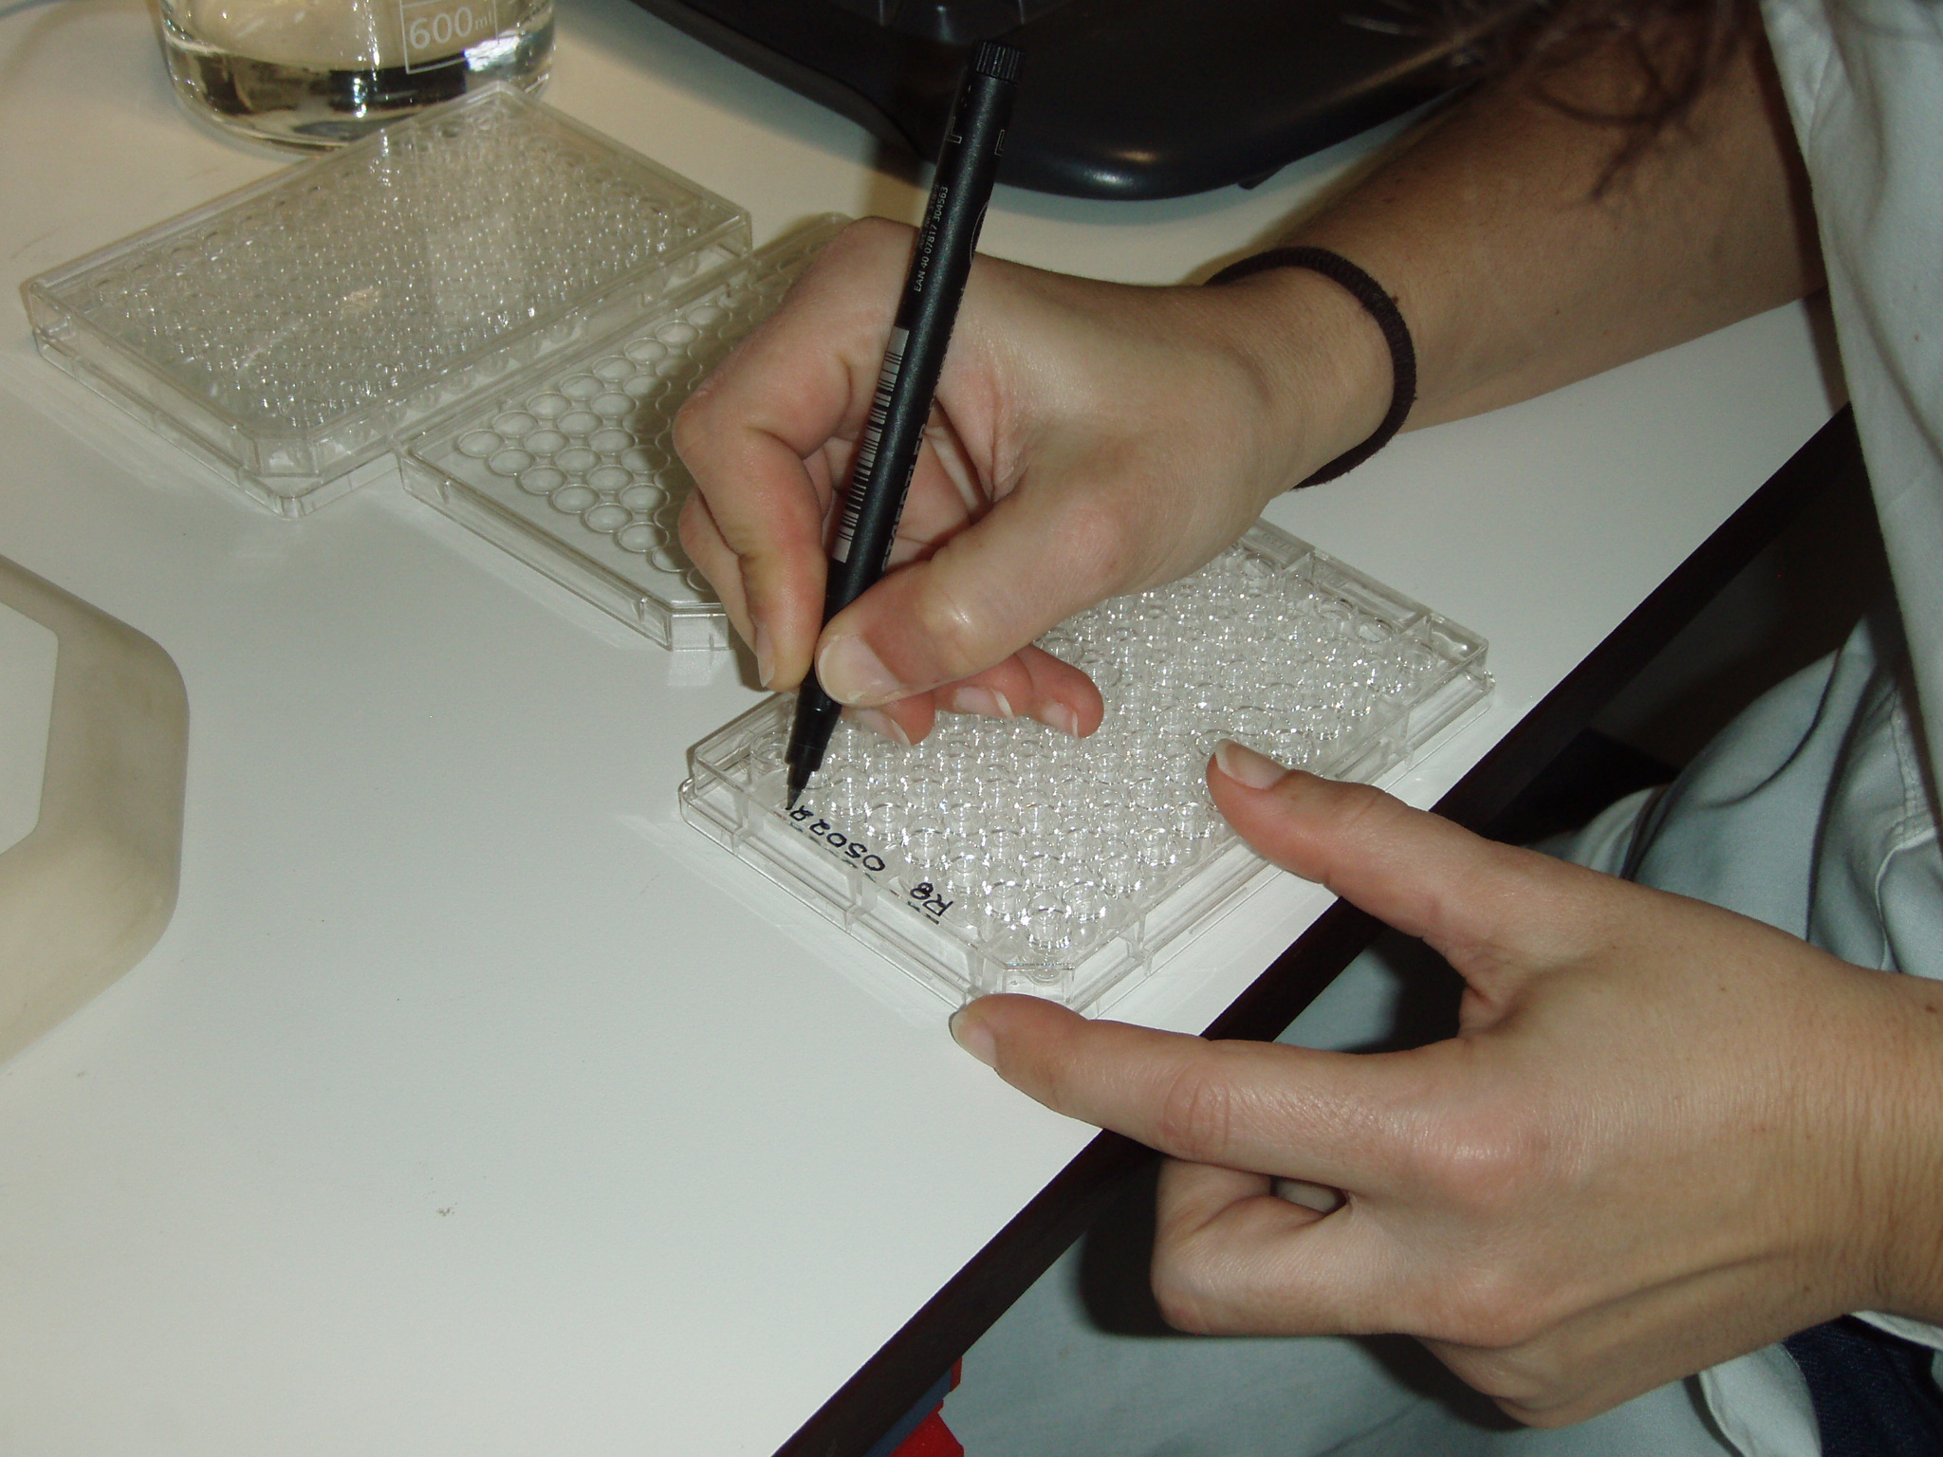
Cleaning the eggs for loading the microtiter plates (Step 5, continued):
Once the eggs float to the surface, collect some (200-300) with the small sieve, rinse them again with sterilized seawater and put them in a Petri dish with sterilized sea water, almost filling the petri dish.
Put the beaker in the incubator, and keep it until you prepare the mct plates. You may need to get more eggs for loading the mct plates.
Cut the tip of a 1000 µl pipette tip using a scalpel blade, so that the opening will allow an egg to be aspirated inside. Set a 1-ml pipette to 200 μl.
Label 2 mct plates with the Tank #, date and replication (e.g., G5-20140228a & b)

Slide 8
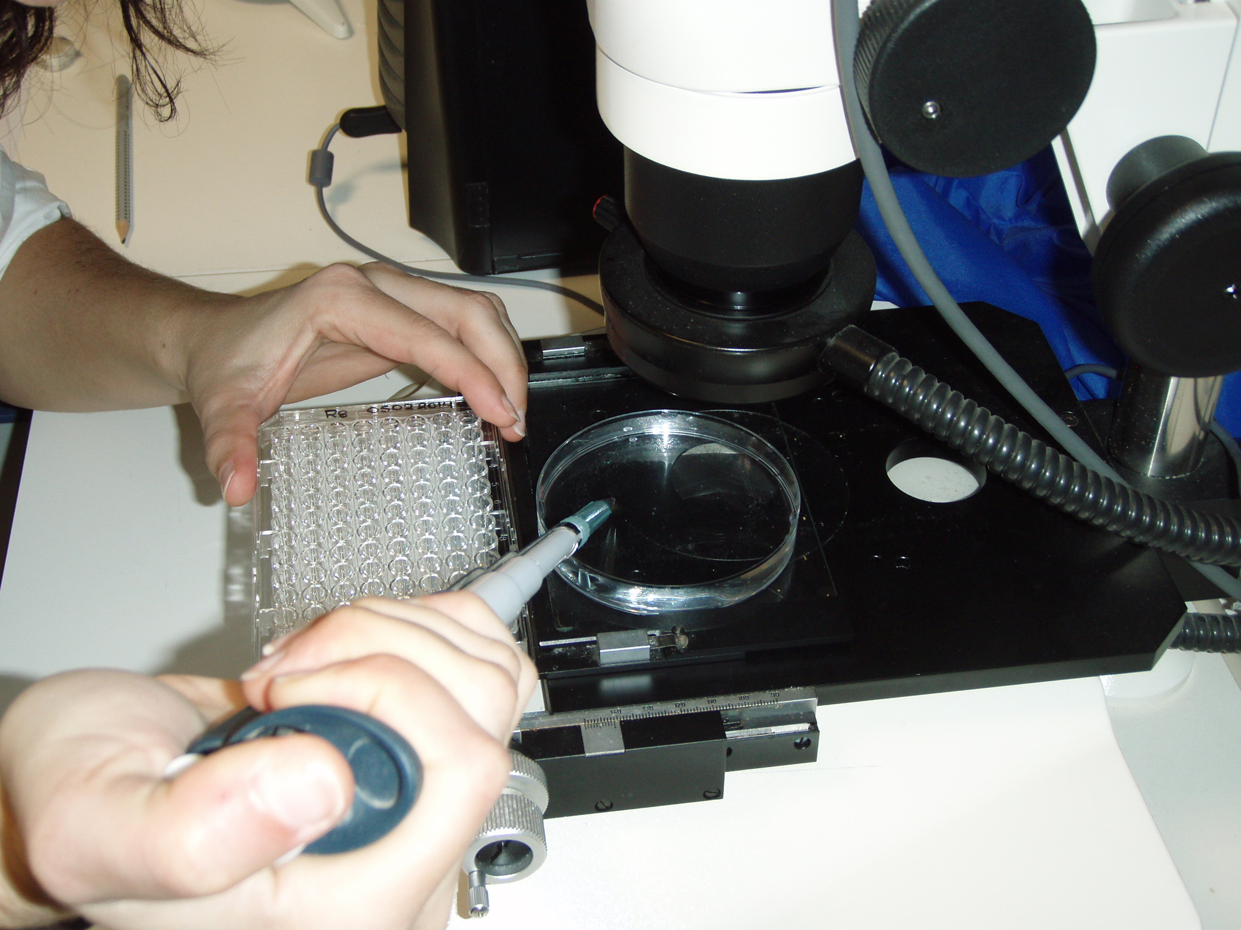
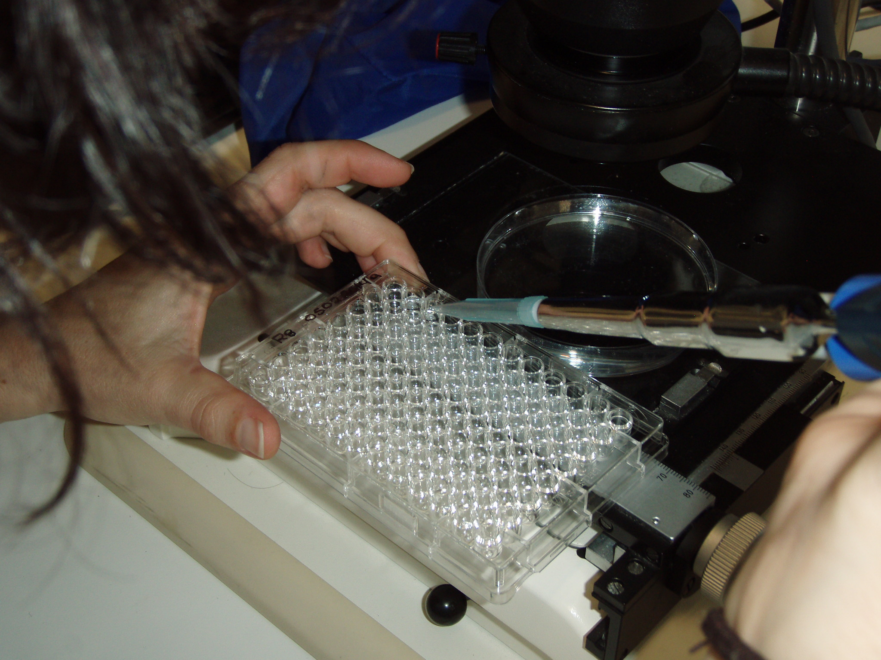
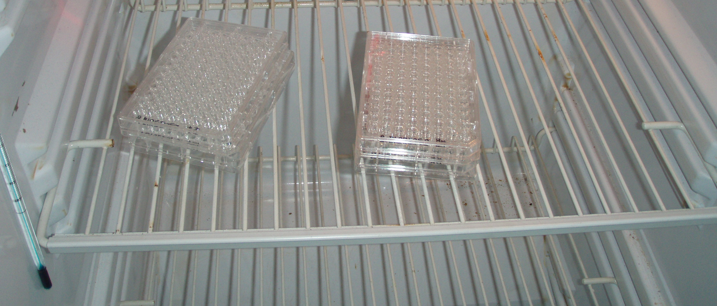
Loading of the microtiter plates (Step 6):
Using the 1-ml pipette set at 200 μl, aspirate one (1) egg at a time with 200 μl of water, with a swift motion, putting the pipette close to an egg and using the aspiration created by the pipette to suck it inside.
Dispense the egg with the 200 μl of water inside each well of the mct plate. Do not take any of the eggs from the bottom of the Petri, as these are probably dead. Take only floating live eggs.
Refill the Petri with sterilized seawater when needed: the more water and less eggs, the easier it is to load the eggs with the pipette.
After completing the loading of the whole mct plate, use the stereoscope to check if there is one (1) live egg in each well.
If you find 2 or more eggs or a dead egg, remove them and place a new one. Prepare 2 mct plates for each spawn to be monitored.
Put the lids on the mct plates and put them in the controlled temperature incubator at the spawning temperature of the water.
Warning!!! Do not leave the Petri dish on the microscope for too long with full light, as the water will warm up rapidly. Use low light intensity and be quick!!!

Slide 9
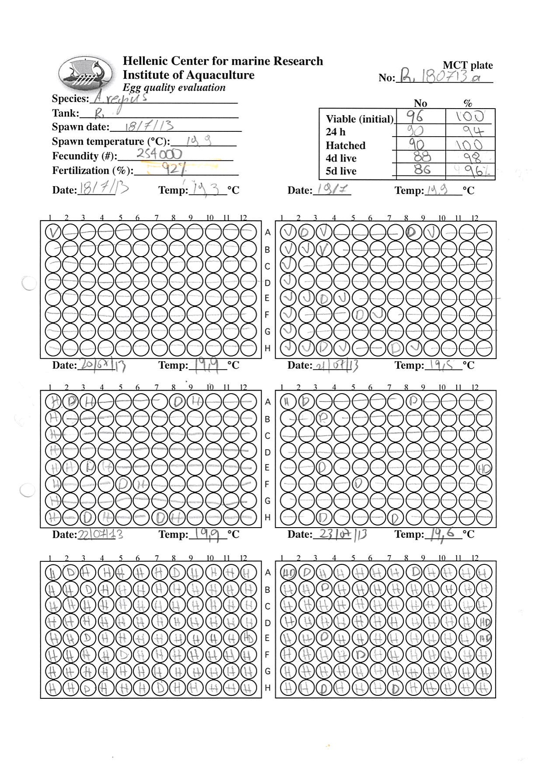
Prepare the monitoring sheets for each microtiter plate (Step 7):
Fill up the information on the top of each mct plate data sheet, including the following information:
Species
Tank
Spawning date
Spawning water temperature
Fecundity (from Step 4)
Fertilization % (from Step 4)
Number of viable eggs loaded (should be 96)

Slide 10
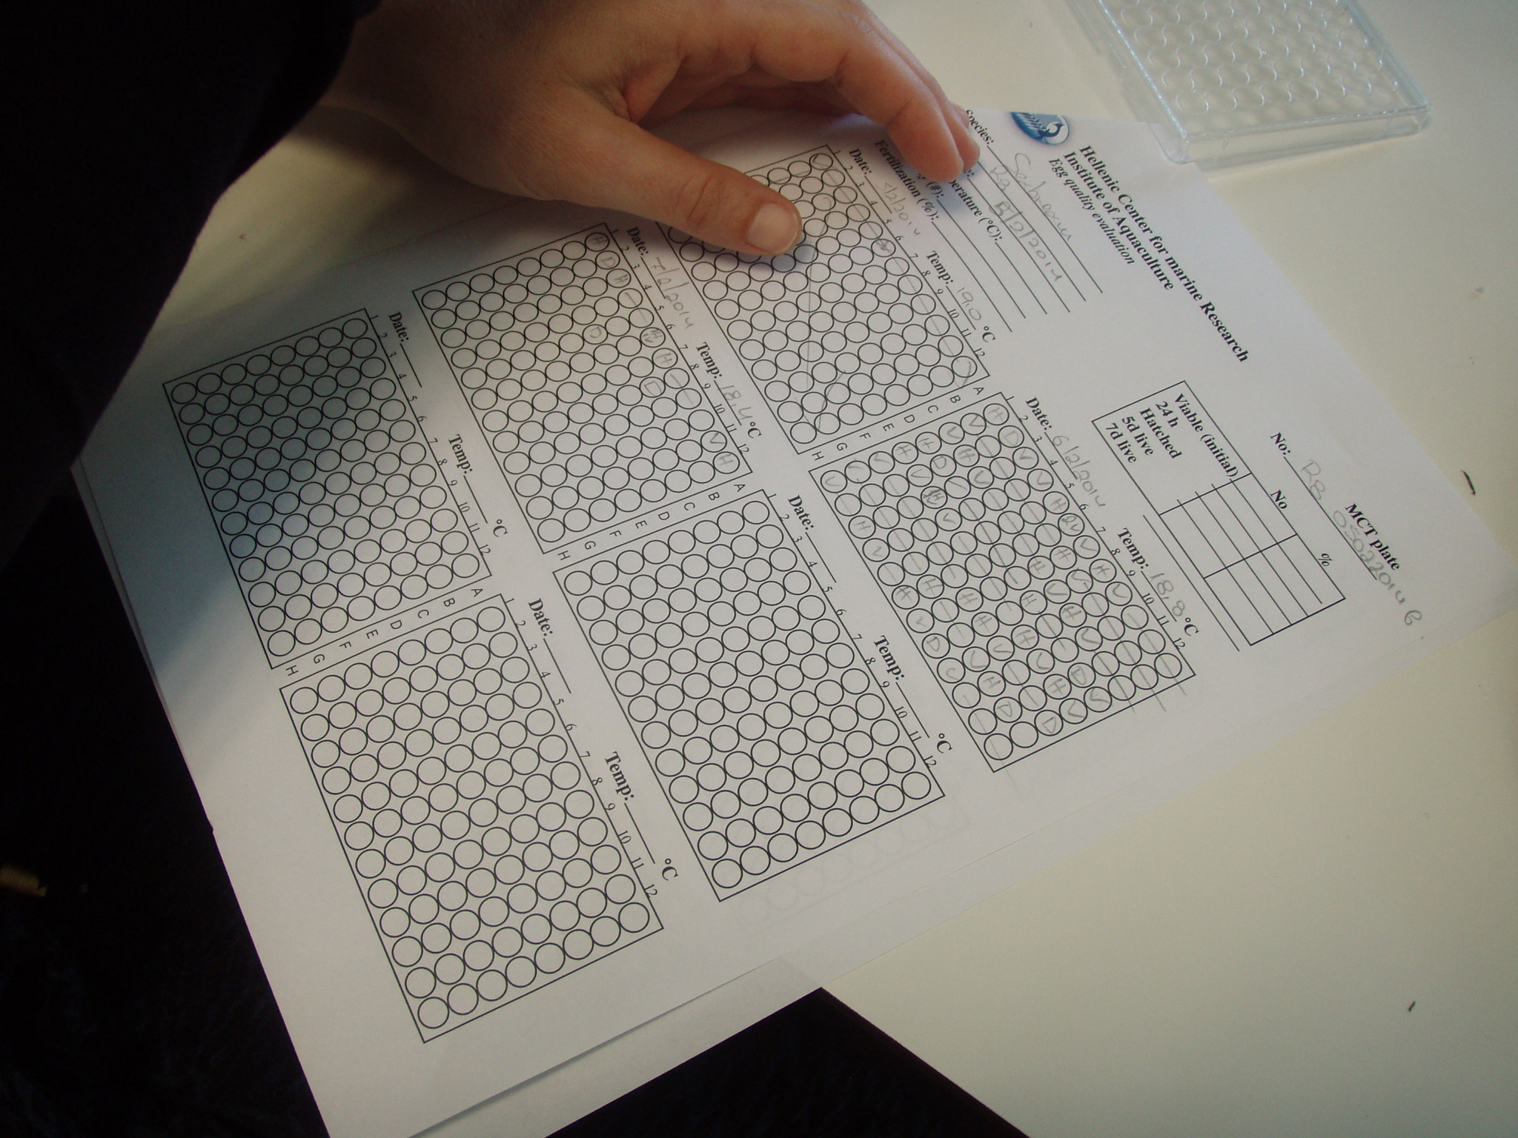
Monitor development and survival in the microtiter plates (Step 8):
Every monitoring day, record the temperature of the incubator and examine the mct plates. We usually examine at 1 d after spawning (24 h embryo survival), 2 and 3 d after spawning (hatching), and 4 and 8 d after spawning (larval development and yolk sack absorption).
Take the mct plates out of the controlled temperature incubator and examine them under the stereoscope (with the lids on), and score each well as follows (see also example in the next slide):
V = viable, alive egg
D = dead egg
H = hatched egg, larva
HD = dead larva (hatched, but it is now dead)
More classifications are possible (e.g. S = skeletal deformity)
Warning!!! Do not leave the mct on the microscope for too long with full light, because the water will warm up rapidly. Use low light intensity and be quick!!!

Slide 11
Calculation of survival parameters (Step 9):
When data collection is finished (day 8), fill up the information at the top right of the data sheet, with the number (#) of eggs/larvae in the different classifications and % survival, as follows:
#24 h = number of viable eggs 1 day after spawning. The 24 h % = #24 h / #V (initially loaded)
#Hatched = the total number of hatched eggs, both live (H) and dead (HD). The hatched % = #Hatched / #24 h
#4d live = number of live larvae at 4 days after loading. The 4d live % = #4 d live / #Hatched
#8d live = number of live larvae at 8 days after loading. The 8d live % = #8d live / #Hatched

Slide 12
Calculation of survival parameters (Step 9, continued):
We consider estimating the percentage survival to the different stages by using in the denominator the number of individuals that survived to the previous developmental stage, as a more independent evaluation of survival within specific developmental stages, without the potential of a masking effect of the survival during the previous developmental stage.
In addition, one can develop egg and larval quality indicators that could be used in commercial hatcheries to predict the performance of a batch of eggs obtained, by examining the existence of correlations among fecundity, fertilization, embryo survival, hatching and larval survival.

Slide 13
Monitoring egg development and larval survival using the microtiter plate method - example data sheet

Slide 14
Institute of Marine Biology, Biotechnology and Aquaculture
Egg quality evaluation
No 96w-mct:_______________________
Species:___________________________
Tank:_____________________________
Spawn date:________________________
Spawn temperature (°C):____________
Fecundity (#):_____________________
Fertilization (%):___________________
No %
Viable (initial __________________
24 h __________________
Hatched __________________
4d live __________________
8d live __________________
Date:_______ Temp:_______°C
Date:_______ Temp:_______°C
1
2
3
4
5
6
7
8
9
1
0
1
1
1
2
1
2
3
4
5
6
7
8
9
1
0
1
1
1
2
A
B
C
D
E
F
G
H
Date:_______ Temp:_______°C
Date:_______ Temp:_______°C
1
2
3
4
5
6
7
8
9
1
0
1
1
1
2
1
2
3
4
5
6
7
8
9
1
0
1
1
1
2
A
B
C
D
E
F
G
H
Date:_______ Temp:_______°C
Date:_______ Temp:_______°C
1
2
3
4
5
6
7
8
9
1
0
1
1
1
2
1
2
3
4
5
6
7
8
9
1
0
1
1
1
2
A
B
C
D
E
F
G
H

